Slide 1
Magnetometry based on defects in isotopically pure silicon carbide
Quantum for International Workshop, Rome, NY June 25-27, 2024
Allan Bracker, Ignas Lekavicius, S. Carter, S. White², D. Pennachio¹, A. Yeats¹, J. Hajzus³, A. Purdy¹, T. Reinecke¹ , E. Glaser¹, and R. Myers-Ward¹
¹US Naval Research Laboratory, Washington, DC 20375, USA
²NRC Research Associate at the US Naval Research Laboratory, Washington, DC 20375, USA
³ASEE Research Associate at the US Naval Research Laboratory, Washington, DC 20375, USA
⁺Current affiliation: Laboratory for Physical Sciences, College Park, MD, 20740, USA
DISTRIBUTION STATEMENT A: Approved for public release, distribution is unlimited.

Slide 2
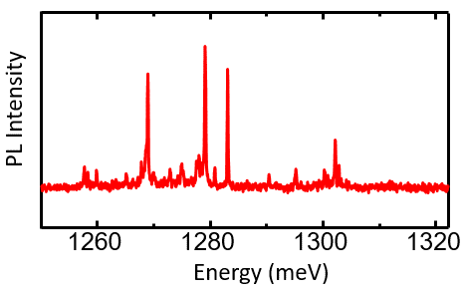
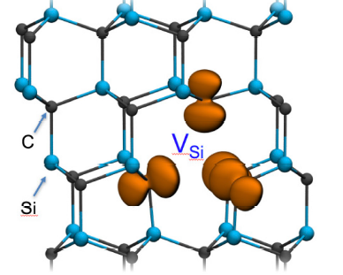
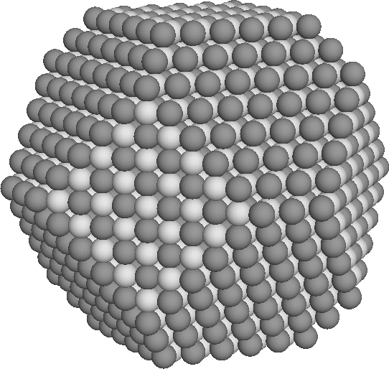
Quantum systems in semiconductors
Crystal defects
Epitaxial quantum dots
Colloidal nanocrystals
Defects in 2D materials.
“Artificial atoms”
Confine electrons in the material.
Discrete orbital energy levels.
Light emission and absorption, optical coherent control.
Advantages
Small size & low power.
Leverage semiconductor industry, potential for integration.
Quantum state “engineering” through growth/fabrication.
InGaAs quantum dot
SiC silicon vacancy
Challenges
Loss of quantum coherence to environment.
Inhomogeneity: hard to make them identical.
Colloidal nanocrystals
2D materials: WSe₂, BN, etc.

Slide 3
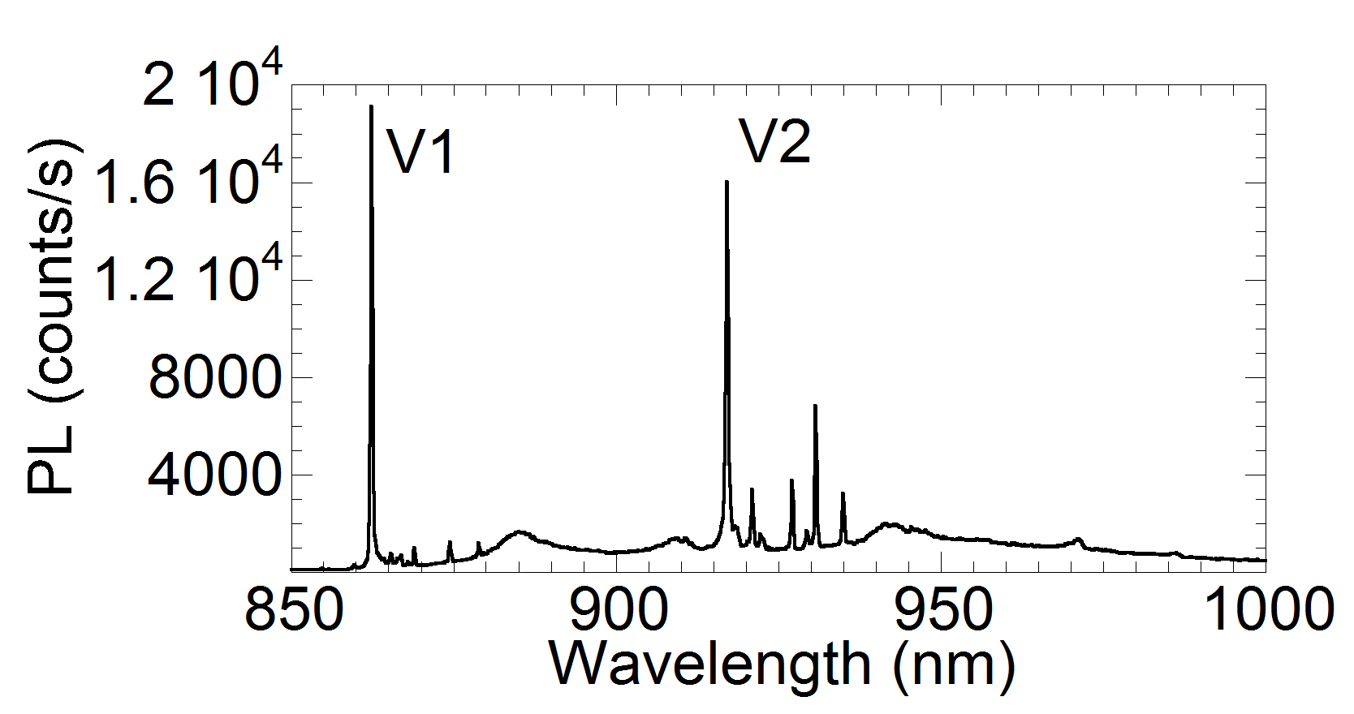
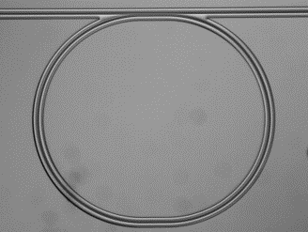
Silicon Carbide for quantum S&T
Silicon Vacancy
atom-like defect
SiC quantum-relevant research activities at NRL
Growth of isotopically-pure SiC
Device fabrication: electronic, photonic, acoustic
Sensing, spin control, quantum optics
Theory & Modelling
optically active spin qubit
SiC growth reactor
Ring resonator waveguide
Atom-like optical spectrum
Code 6880
Code 5613
Advantages
Wafer scale growth & advanced fab
Membrane-substrates for photonic integration
Optical nonlinearity
Doping / electrical control
SiCoI: Silicon-Carbide-on-Insulator

Slide 4
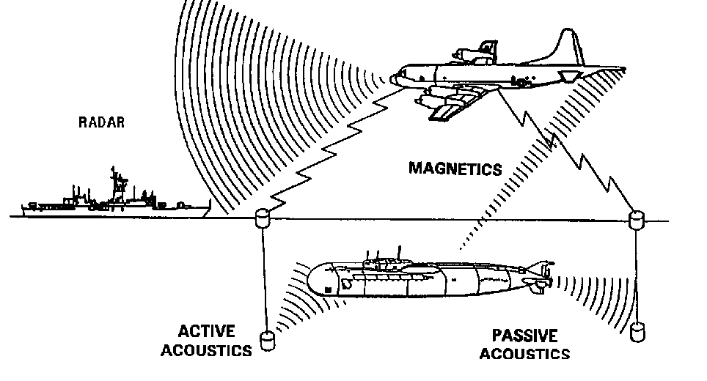
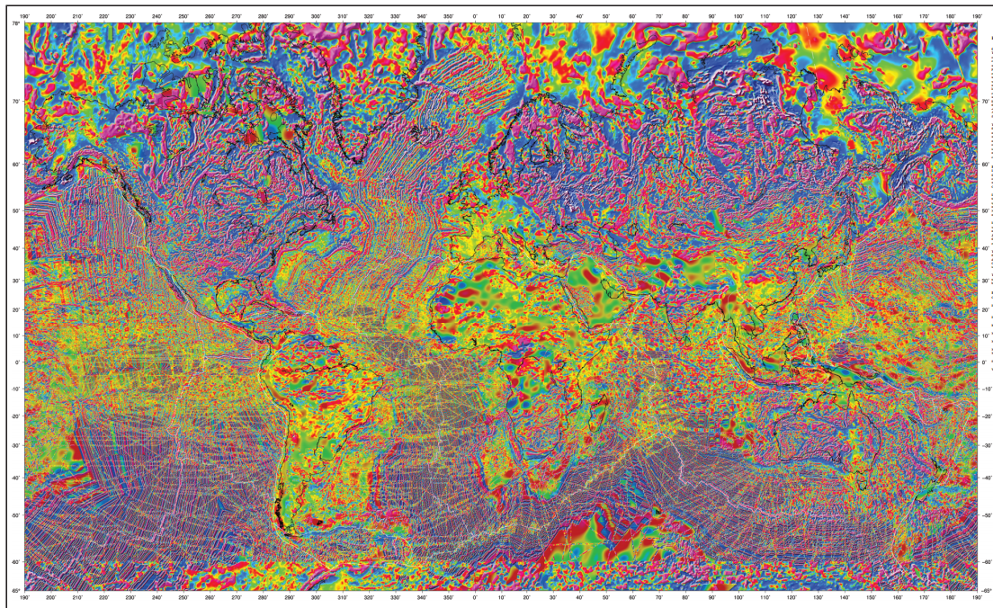
Navy interest in magnetic sensing
Magnetic Anomaly Detection (MAD)
Magnetic Navigation (MagNav)
Magnetic fields from submarines, unexploded ordnance, underground anomalies, and vehicles
Earth’s magnetic anomaly field can be used for navigation

Slide 5
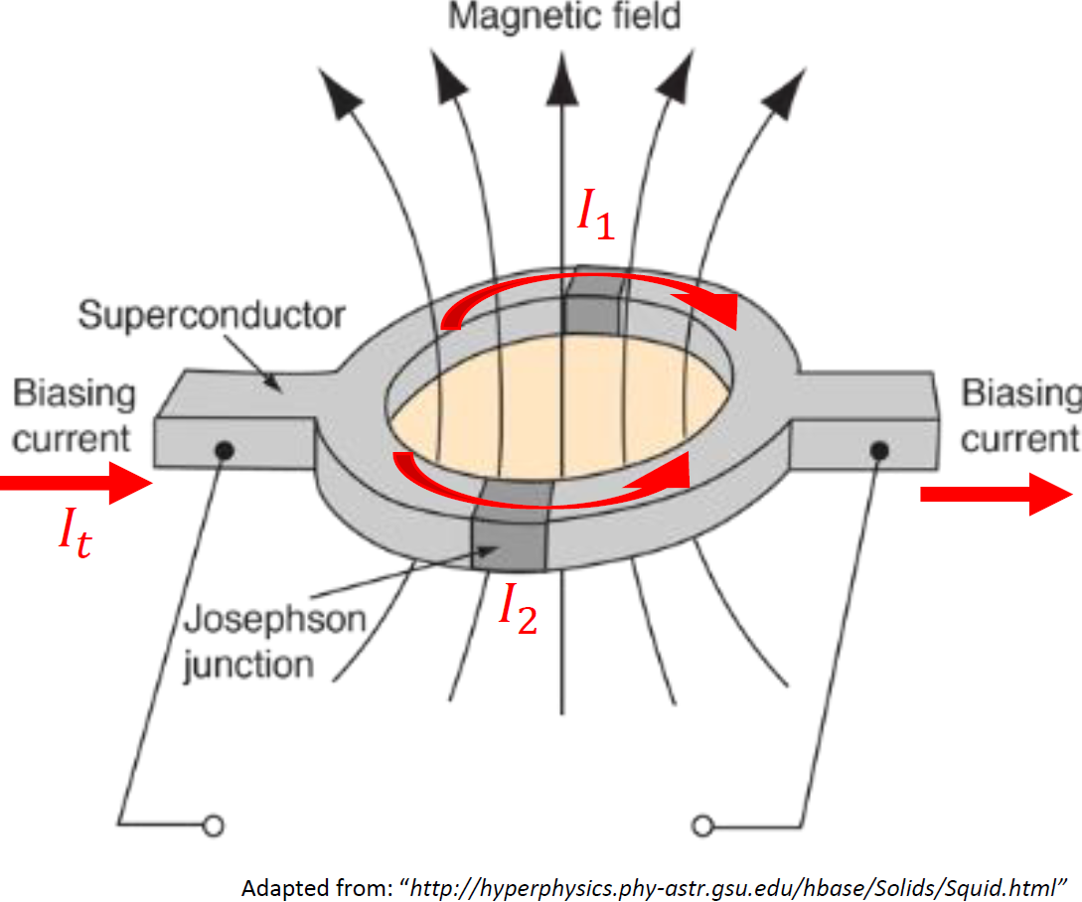
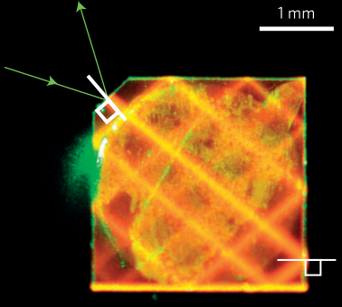
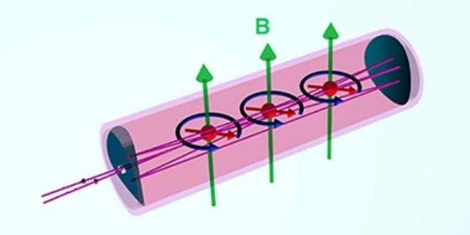
Quantum for magnetometry
State-of-the-art magnetometers are quantum.
SQUIDs
(superconducting quantum interference devices)
Defects in solid state
High dynamic range
Room temperature
Lowest SWaP
Natural vector magnetometer
Relative ease of integration
Demonstrated sensitivity ∼ 1 pT/Hz^{½}
Very sensitive < 1 pT/Hz^{½}
Liquid helium
Big, bulky
Limited dynamic range
Diamond
Atomic vapor
Challenge in SiC: Achieving higher sensitivity
Very sensitive < 1 pT/Hz^{½}
Cryogen free
Challenging integration

Slide 6
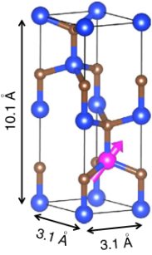
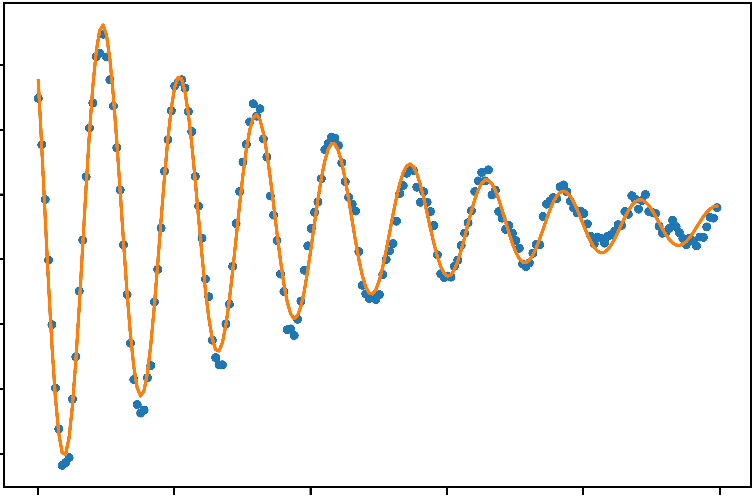
Exploit quantum superposition
Quantum superposition
Measurement: Optically-detected magnetic resonance
Laser initializes spins
RF magnetic field B_{RF} manipulates the spins
Readout with spin-dependent photoluminescence
Superposition coherence is very sensitive to the environment
→ Quantum computing is difficult
→ Quantum sensing is comparatively easy
detector
SiC
lens
laser
Signal frequency relates to magnetic field.
B_{RF}
wave-guide
Superposition phase
c-axis
B_{static}
time

Slide 7
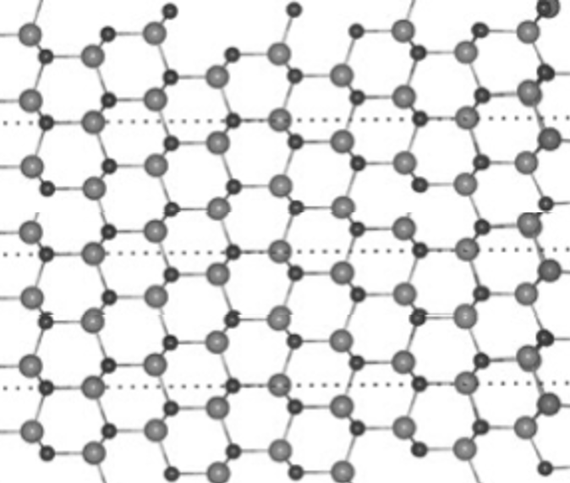
Preserving quantum coherence
Higher quantum coherence translates to greater sensitivity
→ Reduce sources of noise and inhomogeneity that limit coherence
Noisy environment
Nuclear spins in lattice **
Phonons (crystal vibration)
Other defects or electrons nearby
Ensemble inhomogeneity
Crystal environment: strain, electric, magnetic
Measurement: optical power, RF power, bias field
Superposition phase
time
**Natural abundance of spin-containing isotopes in SiC:
²⁹Si: 4.7% and ¹³C: 1.1%

Slide 8
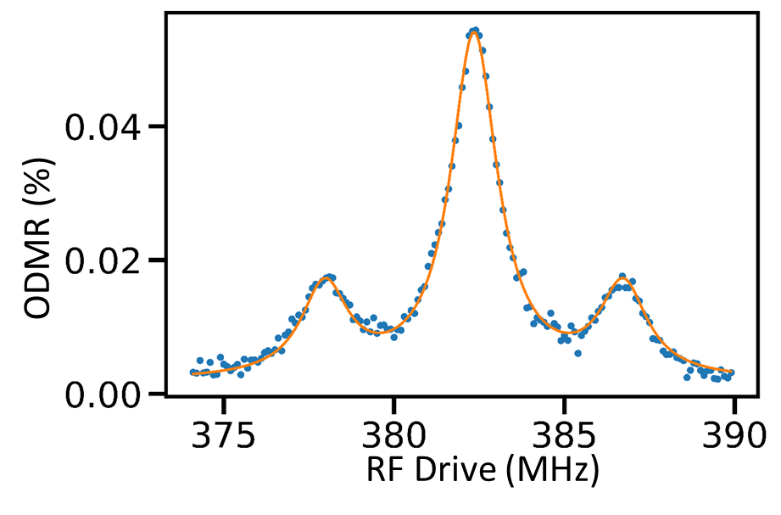
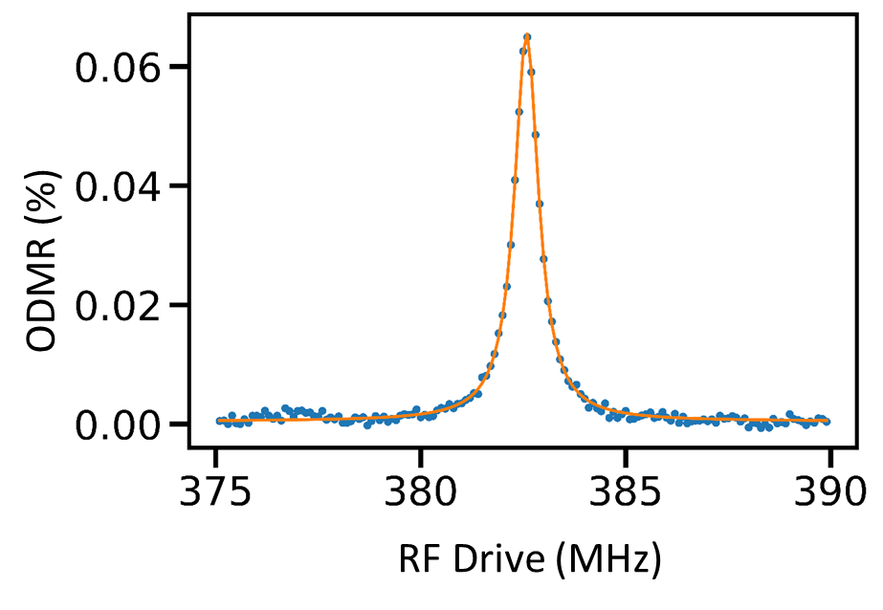
Isotopically Pure SiC crystal growth at NRL
SiC growth reactor
Isotopically pure silane gas synthesized with solid Si by Chemistry Division
Grow isotopically purified 4H-SiC on n-doped substrates (Electronics S&T Division) Reduce ²⁹Si: 4.7% → 0.01%, ¹³C: 1.1% → 0.15%
Electron irradiation creates Si-V defects
Code 6880
SiC Si-Vacancy: Optically-Detected Magnetic Resonance spectra
e⁻ irradiation, dose = {$1×{10}^{17}$,
$3×{10}^{17}$, $1×{10}^{18}$, $3×{10}^{18}$} cm⁻²
Nat. Abund.
Isopure
No ²⁹Si
²⁹Si Hyperfine
Epitaxial growth(~20um)
4H-SiC, commercial n-doped (~500um)

Slide 9
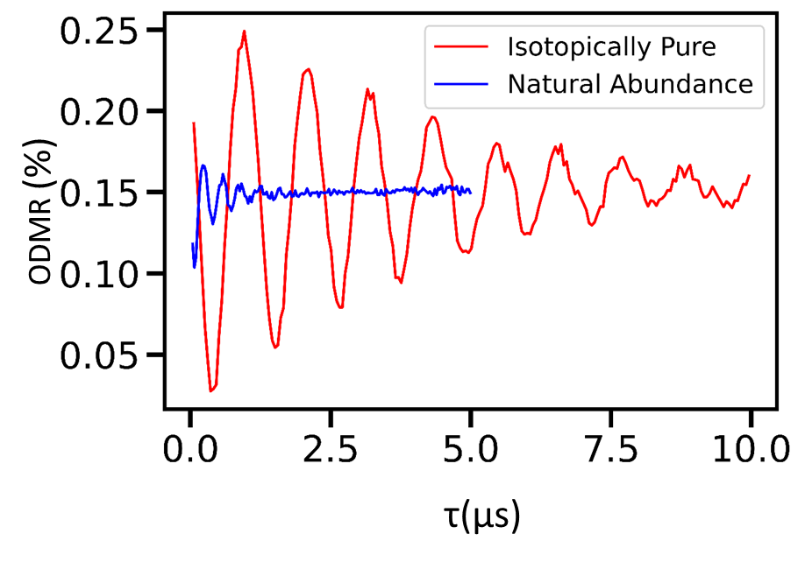
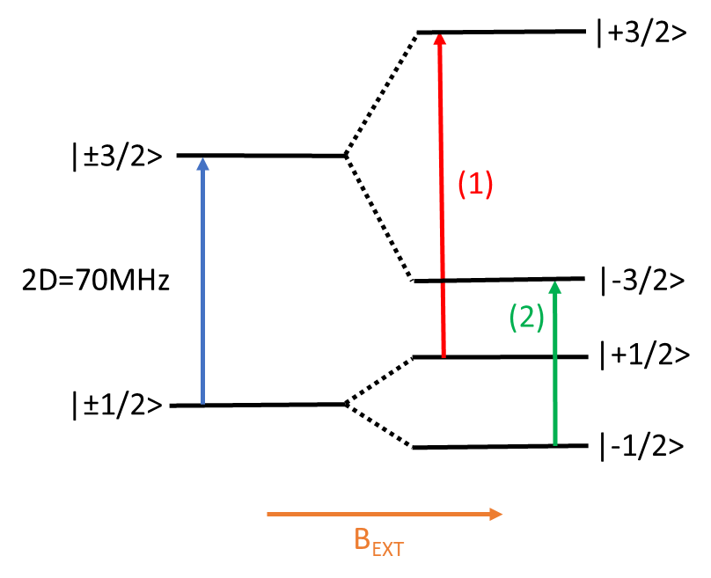
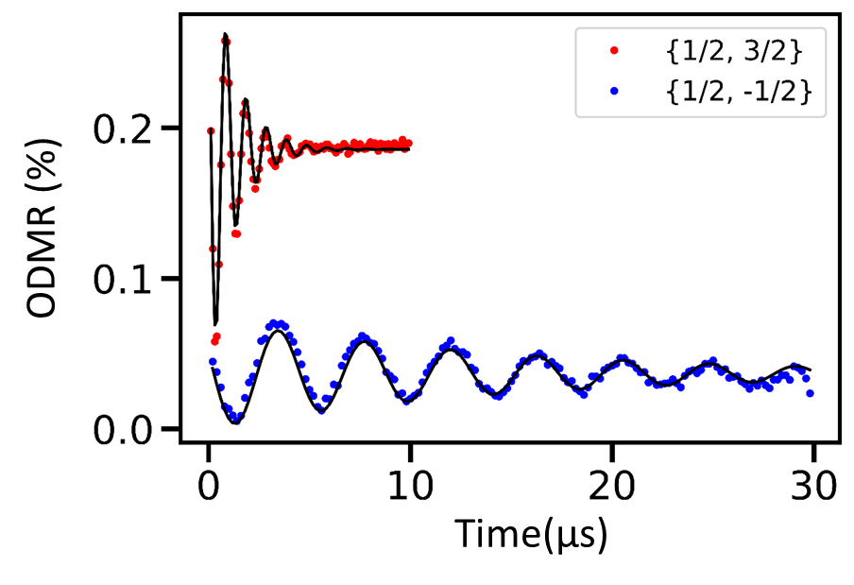
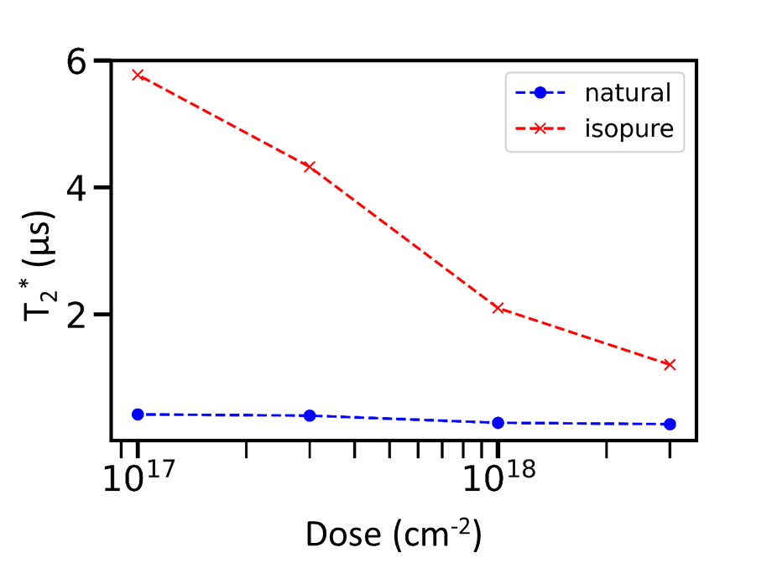
Improvements in spin coherence
Iso-pure SiC: ~10x increase in coherence time (removes nuclear spin effects).
Judicious choice of quantum state transitions: ~10x increase (remove influence of electric field and strain).
Thermal annealing at 600°C: ~50% increase. (Reduces inhomogeneous strain from implantation damage).
T₂*: 0.4 μs → 5.7 µs
T₂: 4.5 μs → 35 µs
Ramsey fringes
Ramsey fringes
PRXQuantum.3.010343

Slide 10
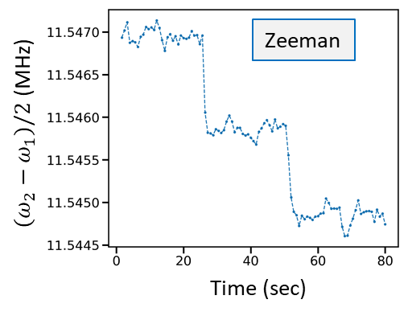
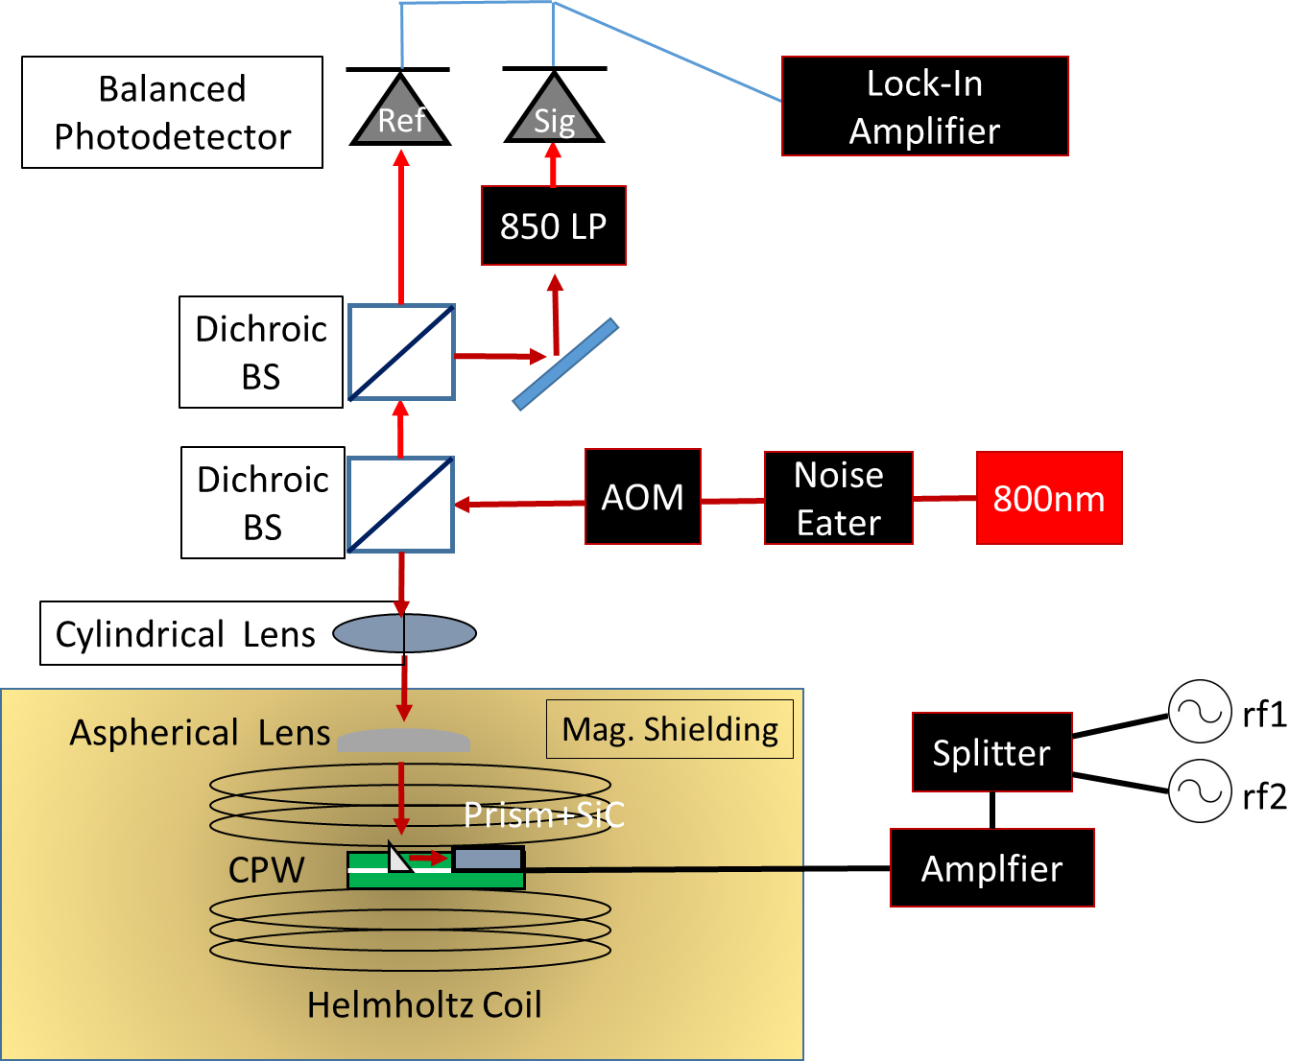
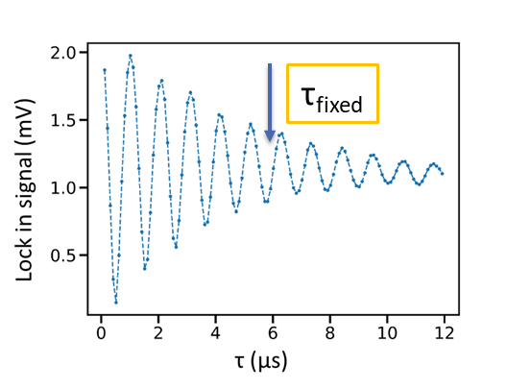
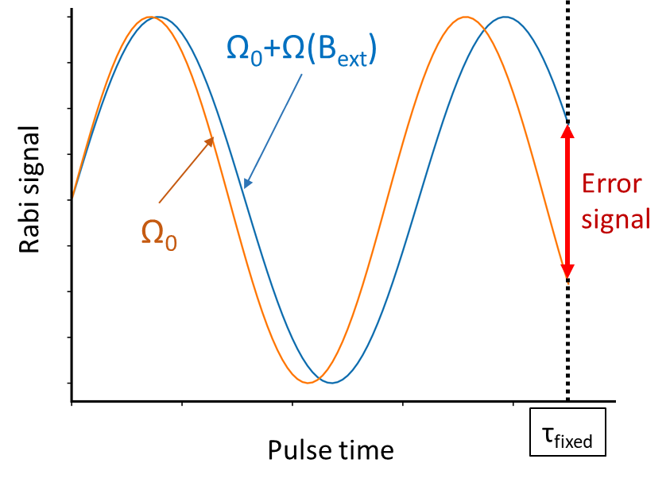
Magnetometry with SiC spins
>10x improvement in DC magnetic sensitivity
Optically-detected magnetic resonance
Laser spin initialization & optical detection
Helmholtz coil for bias field $\vec{B}$
Coplanar waveguide couples RF to SiC
Modulated RF source with Lock-in detection
Detect DC magnetic field
Frequency domain measurement
4nT/√Hz sensitivity
Calculated shot noise limit 2 nT/√Hz
Time domain measurement
4.7nT/√Hz sensitivity
Calculated shot noise limit 200 pT/√Hz
Detect AC magnetic field
Sensitivity for 13 MHz, 101 MHz and 965 MHz detection is 16, 17 and 25 nT/√Hz. (Widely tunable compared to diamond)
Three test fields
detect phase shift at fixed time
PhysRevApplied.19.044086

Slide 11
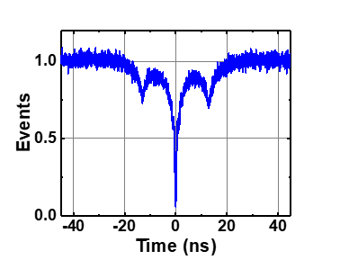
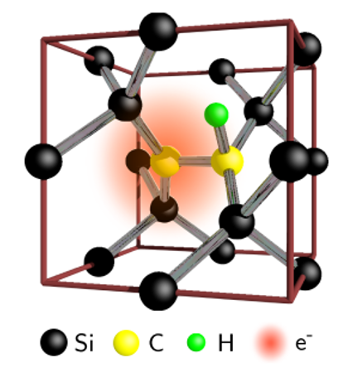
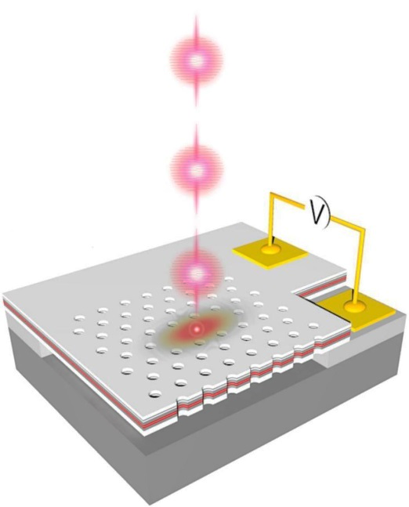
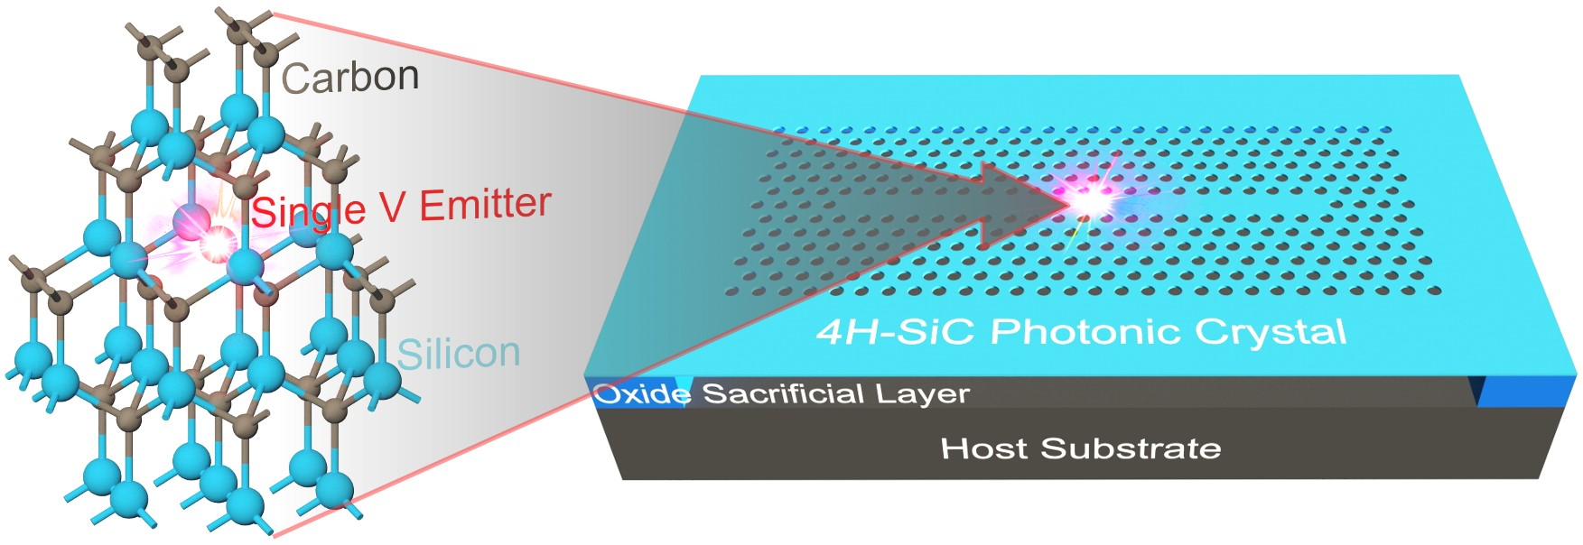
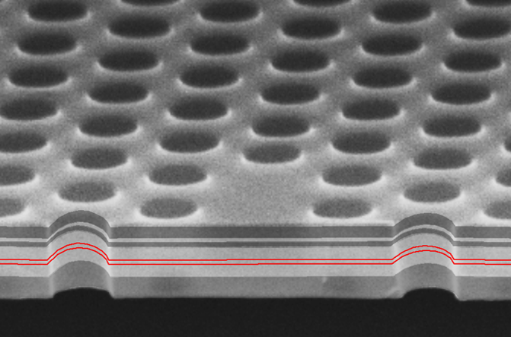
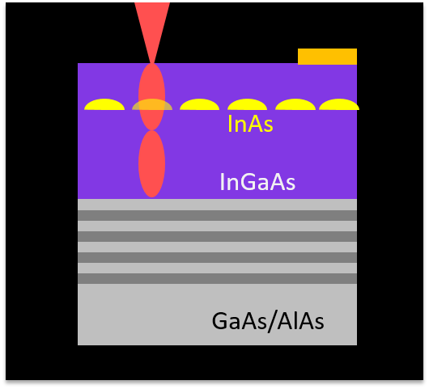
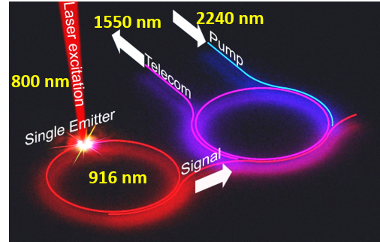
NRL semiconductor quantum research
Wavelength-tunable Single Photon Source
Spin-photon interface in SiC, Si
2-photon interference
InAs Quantum dot
resident electron
spin
Optical Cavity/Waveguide
Brightness
Single photon purity
Indistinguishability
Photonic crystal
Telecommunication Wavelength SPS
Direct growth of quantum dots & nanocrystals
Frequency conversion in SiC
1550 nm

Slide 12
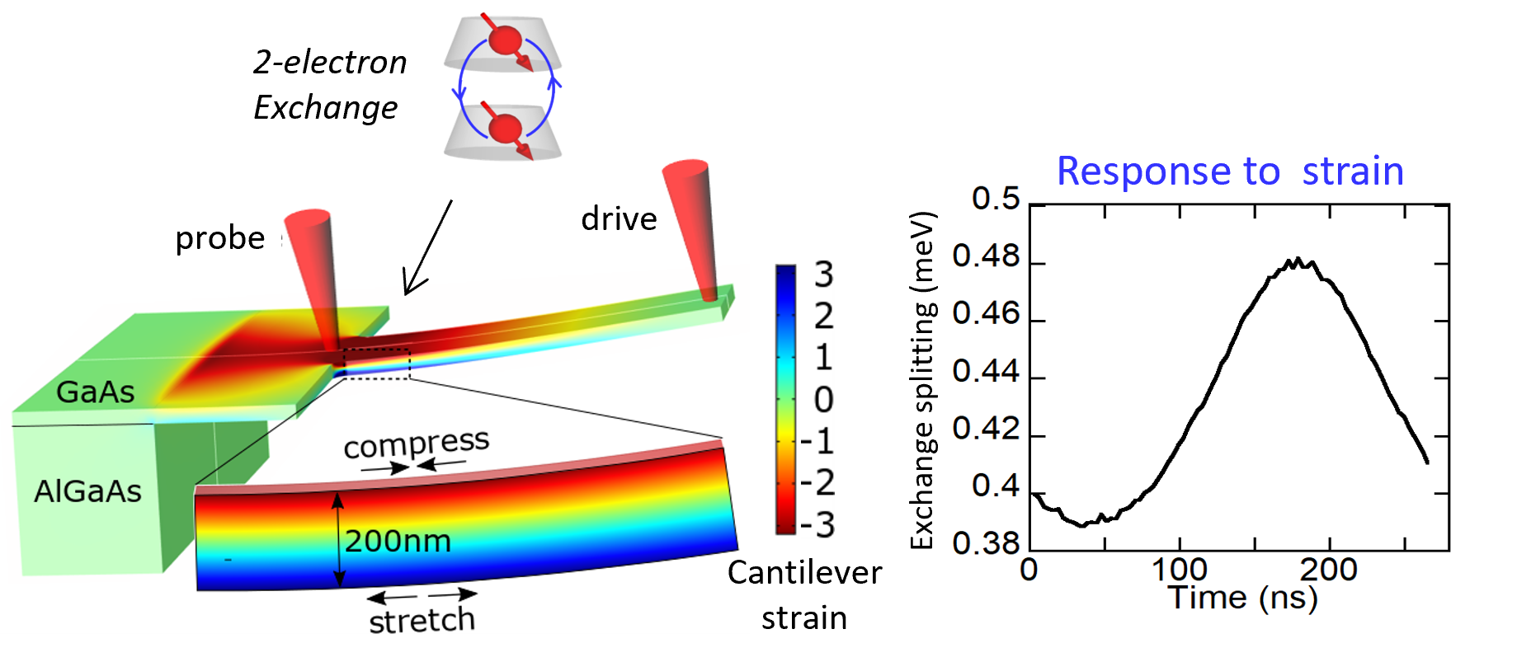
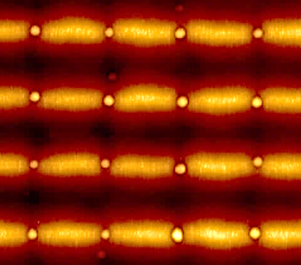
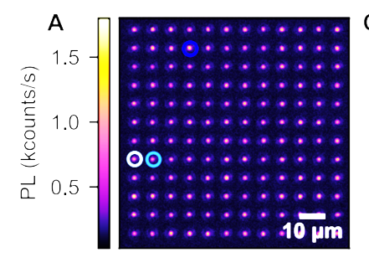
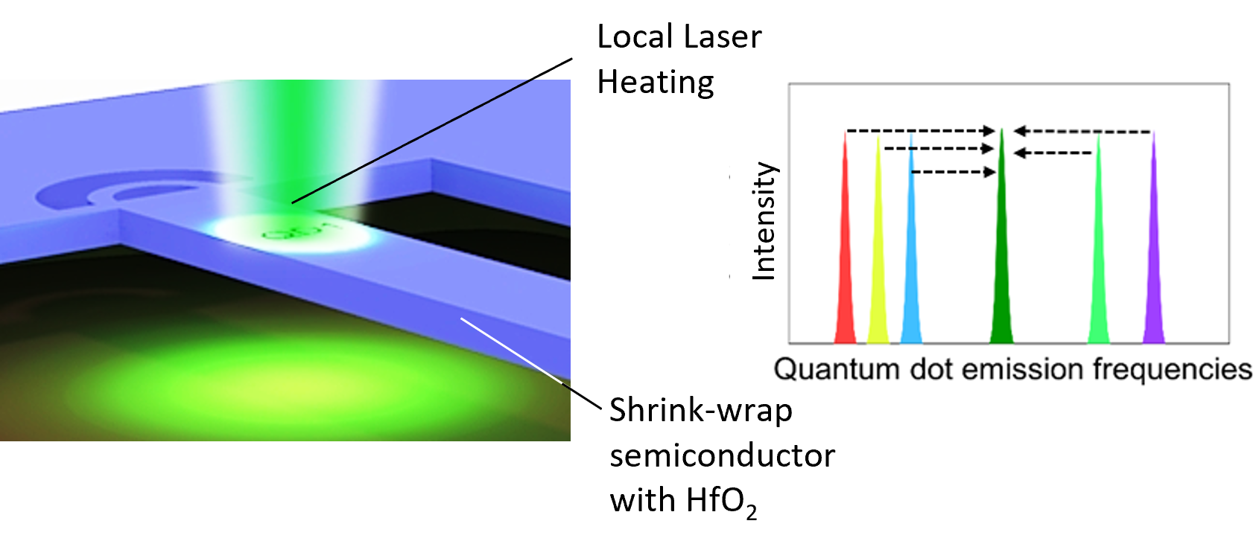
NRL semiconductor quantum research
Sensing strain with quantum dot molecule
Site-control of single photon emitters
Quantum dots
Silicon Carbide
2 μm
AFM image
Light emission
Energy fine-tuning for integration / homogeneity

Slide 13
SiC quantum team
Ignas Lekavicius
Rachael Myers-Ward
Sam Carter (currently at LPS)
Sam White (NRC Postdoc)
Daniel Pennachio
Andrew Yeats
Jenifer Hajzus (ISEE Postdoc)
Andrew Purdy
D. Kurt Gaskill (currently at UMd)
Thomas Reinecke
Evan Glaser
Supported by US Office of Naval Research
Notes:
Add plug to PR Applied if published by then

