Slide 1
Preventing Strategic Surprise from Quantum Computers
Joe Altepeter, Ph.D.
Program Manager, Microsystems Technology Office
June 2024
Distribution Statement ‘A’ (Approved for Public Release, Distribution Unlimited)

Slide 2
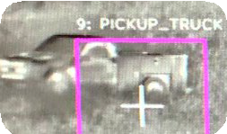
Why are quantum computers strategically important?
Economic Opportunity
Pharmaceuticals ($145B Market)
Image Recognition ($109B Market)
It has been credibly hypothesized – but not proven – that quantum computers would have a transformational impact on many industries.
Examples: Machine learning, quantum chemistry, materials discovery, molecular simulation, many-body physics, classification, nonlinear dynamics, supply chain optimization, drug discovery, battery catalysis, genomic analysis, fluid dynamics, protein structure prediction, solving systems of linear and nonlinear equations.
Battery Catalysis ($141B Market)
Machine Learning ($97B Market)
Nitrogen Fixation ($85B Market)
Encryption ($146B Market)
Security Threat
NIST analysis of the threat:
“If large-scale quantum computers are ever built, they will be able to break many of the public-key cryptosystems currently in use. This would seriously compromise the confidentiality and integrity of digital communications on the Internet and elsewhere.”
NIST on the timeline for cryptographically relevant quantum computers:
“Some engineers even predict that within the next twenty or so years sufficiently large quantum computers will be built to break essentially all public key schemes currently in use.”
Sources: Shutterstock
[Quotes from: https://csrc.nist.gov/projects/post-quantum-cryptography]
Source: Shutterstock
Utility-scale quantum computers have the potential for significant economic disruption

Slide 3
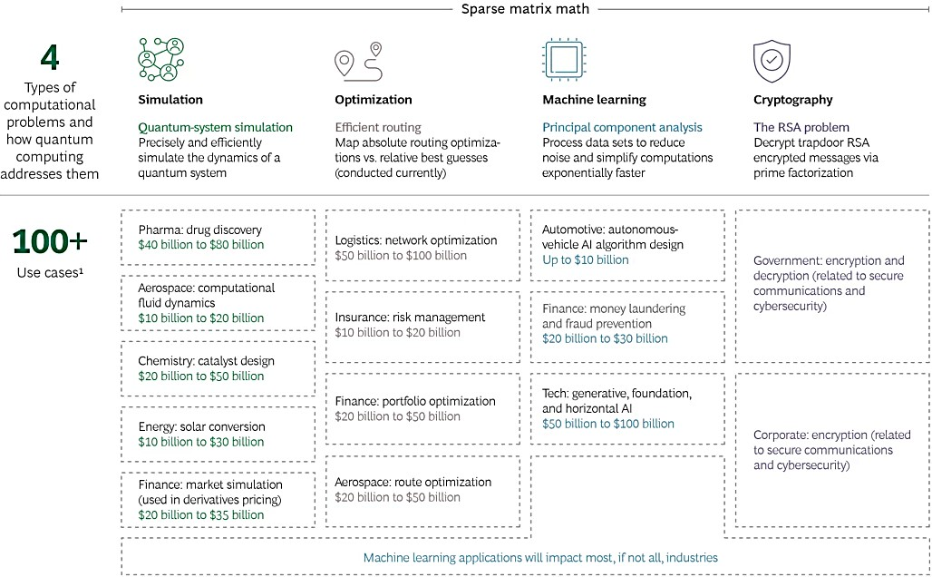
Potential applications of quantum computing: The hype
Boston Consulting Group’s proposed list of quantum computing applications
Optimization and simulation dominate
BCG Estimates a potential value creation of $10B -
$100B each
Source: Boston Consulting Group
Companies have compiled long lists of potential applications without a clear path to realization

Slide 4
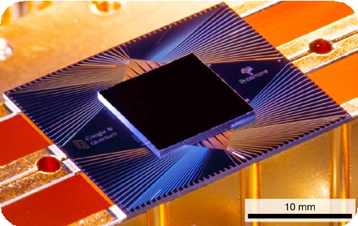
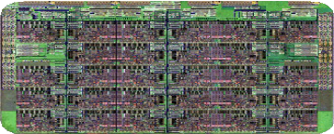
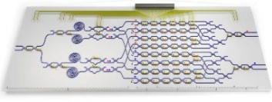
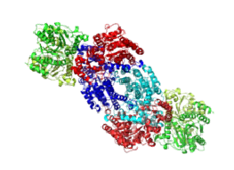
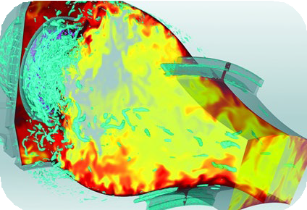
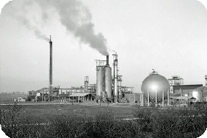
Quantitatively predicting the utility of a quantum computer
superconducting
photonic
classical
Technical Area 1 Creating Benchmarks
Nature 574, 505-510 (2019)
Nature Photon 12, 534–539 (2018)
Source: Fritzchens Fritz
Quantify Application Impact
Parametrize Scope
Define Benchmark
Algorithm Concept
Optimize Algorithm
Map Algorithm to Hardware
Define Hardware Thresholds
material and molecular simulation
fluid dynamics
Technical Area 2 Predicting Benchmark Performance
Source: Jjsjjsjjs
Source: Argonne National Lab
Source: Robin Webster

Slide 5
What did we learn in Phase 1 of the Quantum Benchmarking program?

Slide 6
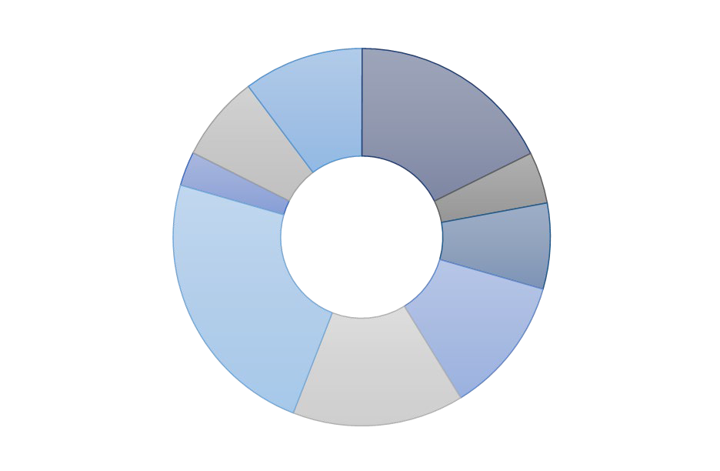
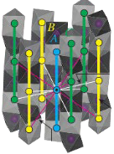
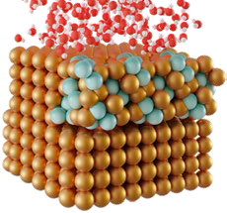
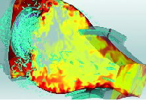
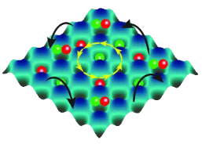
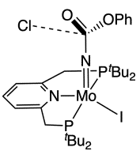
Applications summary
More than 200 applications were documented by DARPA’s Quantum Benchmarking Program in 2022-2023
Using available resources, DARPA has prioritized
~15 applications for examination
Quantum Chemistry
Quantum Dynamics
Materials Science
Source: Los Alamos
National Lab
Quantum Biochemistry
High-Energy Physics
Materials Science
Quantum Chemistry
Machine Learning
Magnetic Memory
Biology & Medical
Fluid
Anti-Corrosion Coatings
Dynamics
Rocket Fuel
Operations
Source: HRL Laboratories
Source:
U.S. Patent US8623337B2
Fluid & Plasmas
Quantum Materials
Quantum Chemistry
Engineering
Incompressible Flow
Source: Argonne National Lab
Staff Experts (50 FTE total) | 61 | Industry | 35 | Government
 | 83 | University | 8 | Nonprofit
Scientific Discovery
Source: A. Polkovnikov
Homogeneous Catalysts
Source: arXiv:2406.06335
Examining quantum utility for a few key problem classes, but many more remain

Slide 7
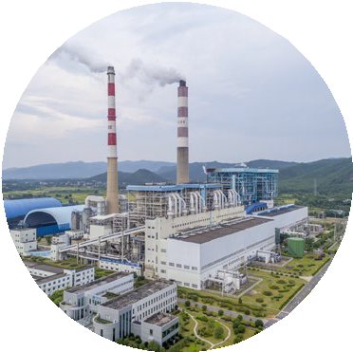
Guidelines for a good quantum application
Clearly defined use-cases with classical and quantum interfaces described
Concrete utility estimation from existing workflows and potential value expansion
Quantum algorithms mapped to application, with clear classical hardware needs
Subject matter experts define the application parameters
Comparison to state-of- the-art classical approaches and limitations
Compiled resources for logical and physical qubits
Application specification
Value of computation
Hardware requirements

Slide 8
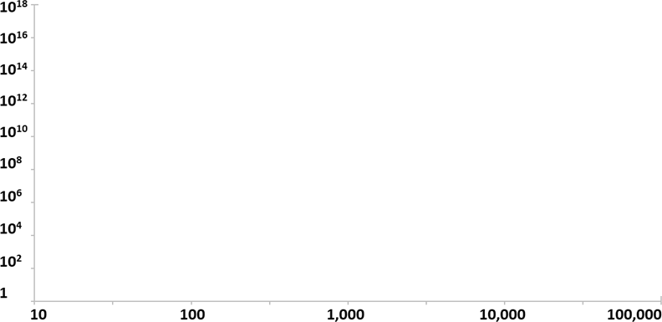
The space of possible quantum computations
Size of Quantum Computer
Size of Computation (# of operations)
Units: Number of computational quantum bits, or “qubits”
In other words:
# of “logical qubits”, for a fault-tolerant computer
# of “physical qubits”, for a non-fault-tolerant computer
A point in this space is a specific quantum computation
Size of Quantum Computation
Units: Number of quantum operations (i.e., quantum gates) in the computation
Cannot be larger than [ 1 / (gate error rate) ]
Equal to: (# of computational qubits) * (circuit depth)
Size of Computer
(# of computational qubits)
Quantum computers are limited by the size of the computer and the size of the computation

Slide 9
The space of possible quantum computations
Trivially Useless Regime
Size of Computation (# of operations)
When (# of gates) << (# of qubits), most qubits are never used; when (# of gates) ≈ (# of qubits), large-scale entanglement is not possible
A high-error computer might be stuck in this regime
Classically Tractable Regime
Classically
Tractable
Small quantum systems can be efficiently simulated on classical computers
The limit of classical tractability is thought to be between 50-70 qubits, depending on assumptions
Trivially not useful
Size of Computer
(# of computational qubits)
Some quantum computations are clearly not useful

Slide 10
The space of possible quantum computations
Noisy Intermediate Scale (NISQ) Regime
Size of Computation (# of operations)
Physical qubit error rates are thought to be limited to 10⁻³ to 10⁻⁵
This limits the number of useful gates to ~10³ to ~10⁵
Cryptanalytically Relevant
Fault Tolerant Regime
Fault tolerance has never been experimentally demonstrated
Huge systems engineering challenge → 100-10,000 physical qubits per logical qubit needed for fault tolerance
Classically
Tractable
Fault-Tolerant Regime
Cryptanalytically Relevant Regime
NISQ Regime
Trivially not useful
Published journal articles show that a quantum computer of this size can break RSA-2048 encryption [see Gidney-Ekera arXiv:1905.09749v3 (2021)]
Size of Computer
(# of computational qubits)
The boundary between NISQ and Fault Tolerance is unclear and device-dependent

Slide 11
Applications
How is this plot relevant for Applications?
Size of Computation (# of operations)
A quantum circuit that solves a specific application problem can be added to the plot as a single point
Application-related challenges:
Identify useful candidate application problems
Identify fair comparisons to state of the art classical solutions
Define success in a way that allows other novel hardware paradigms to compete against quantum solutions
Define utility → what is the impact of solving the application?
On hybrid quantum-classical algorithms
Note that essentially all potentially useful quantum algorithms, in both the NISQ and fault-tolerant regimes, use quantum computers as a specialized co-processor for a classical system
Size of Computer
(# of computational qubits)
Discovering new applications for quantum computers puts points on the plot
Distribution Statement ‘A’ (Approved for Public Release, Distribution Unlimited)

Slide 12
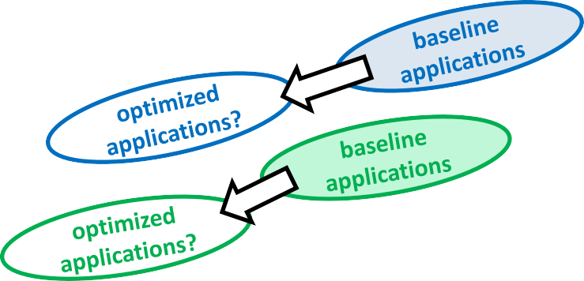
Algorithms
How is this plot relevant for Algorithms?
Size of Computation (# of operations)
For a given application, different candidate algorithms show up as different points on the plots, corresponding to different quantum circuits
Algorithm-related challenges:
Decrease the quantum resources need to solve a given problem through algorithmic optimization
Examples:
General algorithmic compilers
Hardware-specific optimization
Application-specific optimization
Size of Computer
(# of computational qubits)
Optimizing algorithms moves existing points down and to the left
Distribution Statement ‘A’ (Approved for Public Release, Distribution Unlimited)

Slide 13
Hardware
How is this plot relevant for Hardware?
Size of Computation (# of operations)
A given hardware system is represented by a boundary
Non-fault-tolerant systems are rectangles
They can solve any point inside the rectangle
Fault-tolerant systems are staircases
Example Fault
Tolerant System
They can solve any system down and to the left of the staircase
Increasing the number of physical qubits per logical qubits decreases both gate error probability and number of usable logical qubits → this creates a staircase shape
Example Noisy Intermediate
Scale (NISQ) System
(solvable region)
Hardware-related challenges:
Create hardware that can solve larger, more complex, longer computations
Size of Computer
(# of computational qubits)
Creating bigger, better quantum computers moves hardware boundaries up and to the right
Distribution Statement ‘A’ (Approved for Public Release, Distribution Unlimited)
13

Slide 14
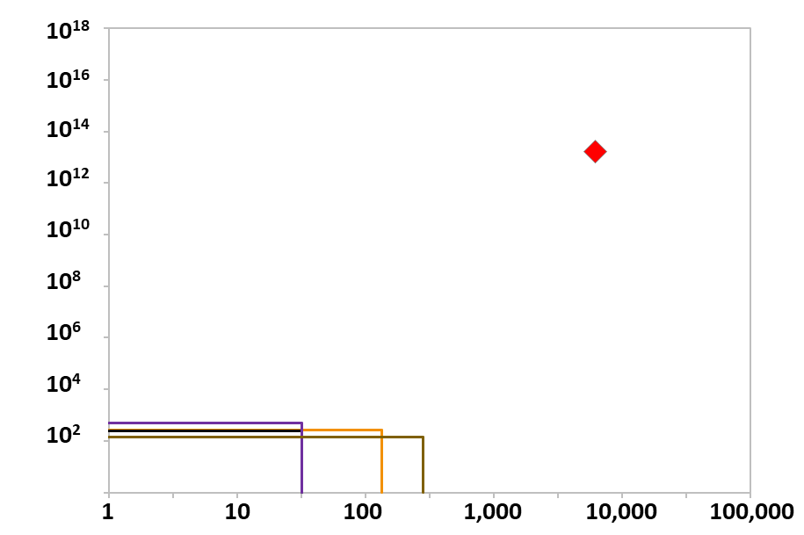
For reference → Existing hardware demonstrations
NISQ systems
Computation Size (Number of Operations)
Noisy-intermediate-scale-quantum (NISQ) computers appear as rectangles; the upper right corner represents the largest computation that can be done
Current generation systems have <1,000 qubits and <10⁴ computational volume
Computer Utility
RSA-2048
Where do known algorithms lie on this plot?
NISQ Systems
IBM Heron (2023)
IonQ Forte (2022)
Quantinuum H2 (2022) Harvard – QuEra (2023)
The well-known Gidney-Ekera estimate for factoring RSA-2048 is the red dot that requires around 6,000 logical qubits and a computational volume of 10¹³
System Size (Number of Computational Qubits)
Current quantum computers are far too small and noisy to be relevant for factoring
14

Slide 15
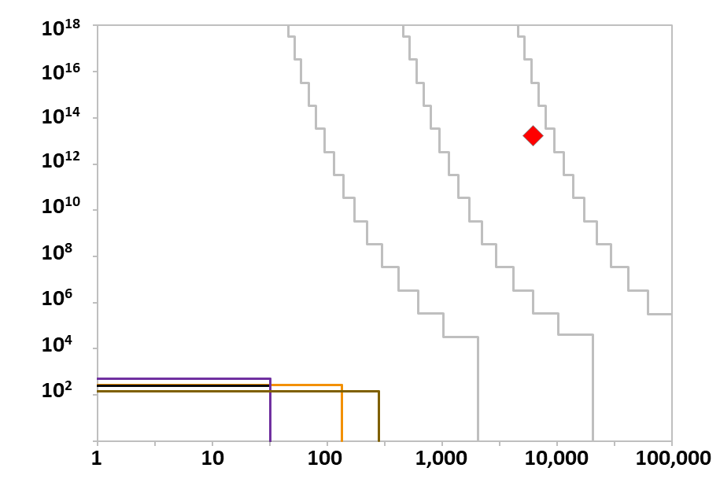
Plotting generic fault tolerant machines in this space
Fault-tolerant systems
Computation Size (Number of Operations)
Physical Qubits with 99.9% fidelity
10⁵
10⁶
10⁷
Idealized reference systems are shown for different numbers of physical qubits, a physical error rate of 0.1% and a code threshold rate of 1%
A system with 10⁷ physical qubits would be sufficient to factor RSA- 2048
Computer Utility
RSA-2048
Are these staircases realistic?
NISQ Systems
NISQ Systems
IBM Osprey (2022)
IonQ Forte (2022)
Quantinuum H2 (2022) Harvard – ONISQ (2022)
IBM Heron (2023)
IonQ Forte (2022)
Quantinuum H2 (2022) Harvard – QuEra (2023)
Specific hardware implementations will have many engineering challenges, and may or may not be reconfigurable for different code distances. However, in principle, these show the space of solvable problems.
System Size (Number of Computational Qubits)
Systems large enough to be cryptanalytically relevant require fault-tolerant operation

Slide 16
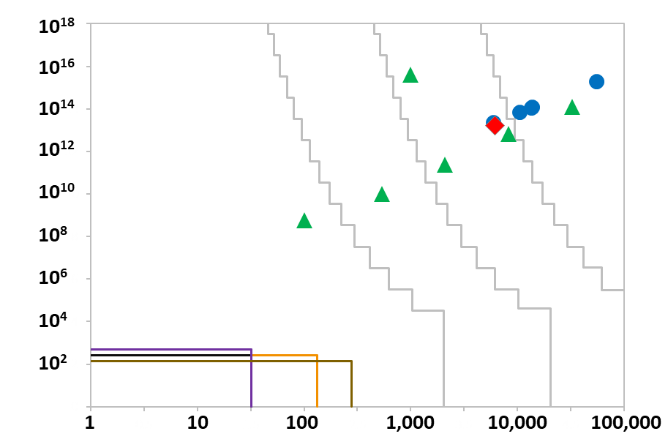
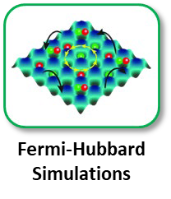
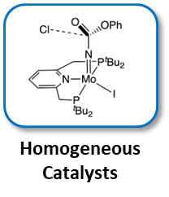
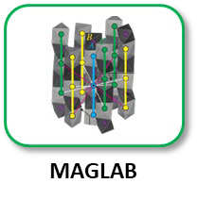
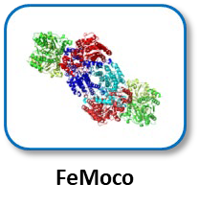
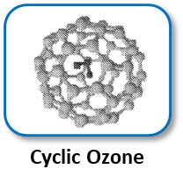
Quantum Benchmarking
Key Question
What is the long-term utility of quantum computers?
Approach
Create hardware-agnostic, application-focused benchmarks for transformational computational problems
Estimate the hardware resources – at both the logical and physical level – needed to execute benchmarks
Results/Plans
Evaluated ~200 candidate applications for economic value, testability, and quantum amenability
Identified the following candidate application instances in the sub-Shor regime; Phase 2 will refine and expand this list
Computation Size (Number of Operations)
Physical Qubits with 99.9% fidelity
10⁵
10⁶
10⁷
Computer Utility
Scientific Industrial RSA-2048
NISQ Systems
IBM Heron (2023)
IonQ Forte (2022)
Quantinuum H2 (2022) Harvard – QuEra (2023)
System Size (Number of Computational Qubits)
Identify and benchmark quantum computing applications with clear economic value

Slide 17
Potential resource reductions
Optimization | Applicable Application Instances | Estimated Resource Reduction
Use first quantization encoding instead of second quantization | Cyclic Ozone, Ru MACHO, FeMoco, Mg2+ Slab Small/Large | Ref. [1] shows that selected applications can achieve a 100x reduction in qubit count and 10x reduction in T-count.
Advanced factorizations in second quantization | Cyclic Ozone, Ru MACHO, FeMoco, Mg2+ Slab Small/Large | More efficient factorizations in second quantization exist than the dual-plane- wave basis used in the initial estimates shown in figure on slide 17, including: sparse [2], single [3] and double [4] factorization, and tensor hypercontraction [5]. These could provide a factor of 10x reduction in T- count.
Bravyi-Kitaev (or other) encoding instead of Jordan-Wigner | Fermi-Hubbard | Ref. [6] shows an exponential decrease in circuit depth at the expense of increased constant factor overhead. For large systems of ~50 spin orbitals, they showed a ~2-4x improvement in gate count, with less improvement for smaller systems.
Trotter Order Optimization | MAGLAB | Current approach uses a second order Trotter approximation. It has been shown in Ref. [7] that going to fourth (or higher) order is beneficial and can reduce gate counts by 10-100x.
Tightened Trotter Convergence Bounds | MAGLAB | Estimates in figure on slide 17 use general Trotter-error bounds, which give guaranteed performance but are not tight. Incorporating known symmetries of the problem and using tighter bounds should reduce gate depth by 10- 100x [8].
Algebraic Optimization | All | Symmetries and other algebraic properties of specific Hamiltonians can be exploited to reduce gate counts using techniques such as fast-forwarding [9]. At best these can produce exponentially reduced circuit depths. We do not incorporate these optimizations into our error bars as they are highly problem dependent.
References
Y. Su, et al., "Fault-Tolerant Quantum Simulations of Chemistry in First Quantization," PRX Quantum, vol. 2,
p. 040332, 2021.
D. W. Berry, et al., "Qubitization of Arbitrary Basis Quantum Chemistry Leveraging Sparsity and Low Rank Factorization," Quantum, vol. 3, p. 208, 2019.
M. Motta, et al., "Low rank representations for quantum simulation of electronic structure," npj Quantum Inf., vol. 7, p. 83, 2021.
V. v. Burg, et al., "Quantum computing enhanced computational catalysis," Phys. Rev. Research, vol. 3, p. 033055, 2021.
J. Lee, et al., "Even More Efficient Quantum Computations of Chemistry Through Tensor Hypercontraction," PRX Quantum, vol. 2, p. 030305, 2021.
A. Tranter, et al., "A Comparison of the Bravyi–Kitaev and Jordan–Wigner Transformations for the Quantum Simulation of Quantum Chemistry," J. Chem. Theory Comput., vol. 14, p. 5617, 2018.
N. J. Pearson, "Thesis: Simulating Many-Body Quantum Systems:," Diss. ETH No. 27032, Zurich, 2020.
A. M. Childs, et al., "A Theory of Trotter Error," Phys. Rev. X, vol. 11, p. 011020, 2021.
S. Gu, et al., "Fast-forwarding quantum evolution," Quantum, vol. 2021, p. 577, 2021.

Slide 18
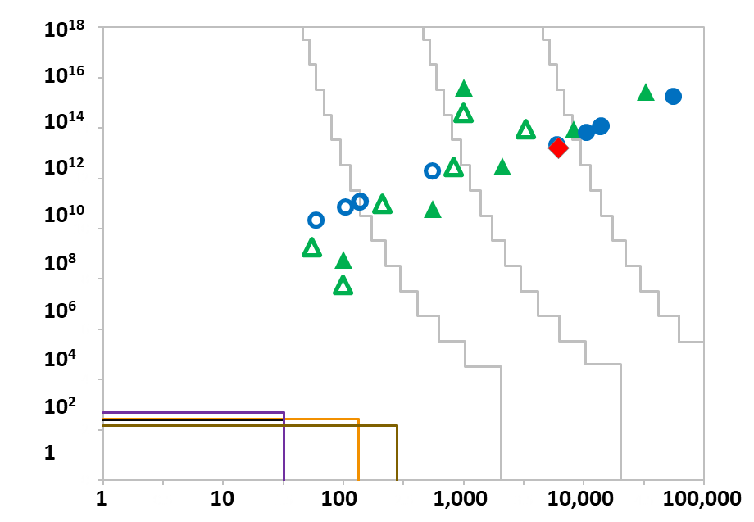
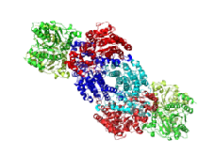
Quantum Benchmarking
❶
❷
Application Resource Estimates
Physical Qubits with 99.9% fidelity
10⁵
10⁶ 10⁷
❷
Computation Size (Number of Operations)
❺
❶
Fermi-Hubbard Simulations
MAGLAB
❻ ❹❸
❶
Computer Utility
❷
Scientific Industrial RSA-2048
Scientific Optimized Industrial Optimized
❶
❸
❹
❺ ❶
❶
❶
❻ ❹❸ ❶
❶
❷
Homogeneous Catalysts
FeMoco
❺
❻
NISQ Systems
IBM Heron (2023)
IonQ Forte (2022)
Quantinuum H2 (2022) Harvard – ONISQ (2023)
Mg-based Anti- Corrosion Coatings
Cyclic Ozone
System Size (Number of Computational Qubits)
Preliminary conclusion → Large-scale quantum computers will likely enable solutions to high-value scientific and industrial problems

Slide 19
Where did we go in Phase 2 of the Quantum Benchmarking program?

Slide 20
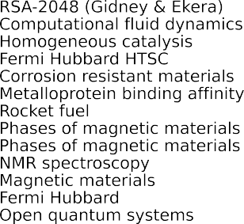
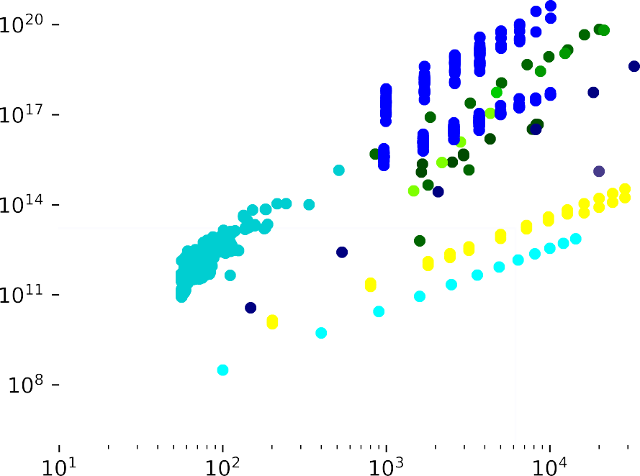
Phase 2 results - Pessimistic
~20 use cases developed
8 application-focused publications on the arXiv this week and next
2 focused on tools for resource estimation
~10 more use cases under active development
Tools for estimating required resources
Automated tools for estimates of utility-scale hardware
Algorithmic refinements and compilation methods
Quantum utility estimates
Phase 2 focuses on applications with clear utility
The remainder of Phase 2 will focus on mapping economic utility estimates to quantum benchmarking metrics
The last six months have significantly increased the number of potential applications

Slide 21
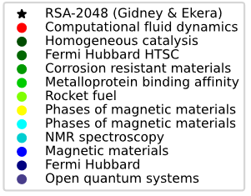
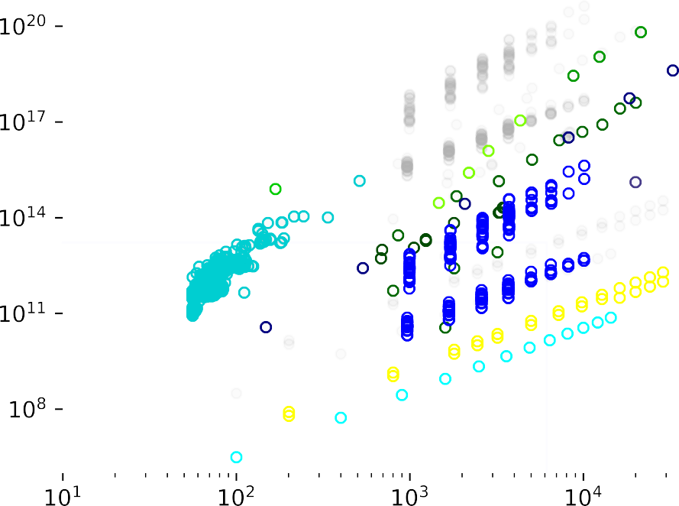
Phase 2 results - Optimistic
Open circles show expected optimizations
Latest algorithmic advances are shown
Includes improved bounds on error tolerances and algorithmic requirements
Not considered: future algorithm improvements
Further resource reductions can also happen through new algorithm development, but are not considered here
Applying known algorithmic advances may have a big impact

Slide 22
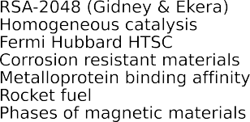
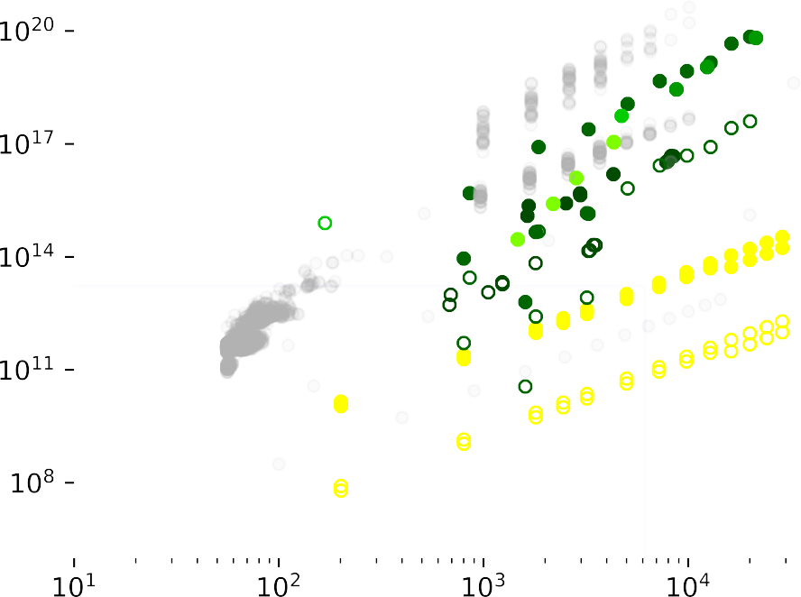
Resource reductions for ground state energy estimation
What optimizations did we assume for ground state energy problems?
For molecular chemistry
1-norm reduction via tensor decomposition¹
Improved error bounds, pre- and post-processing²
1st quantization for problems without active spaces³
Tensor-Hypercontraction⁴
Block Invariant Symmetry Shift⁵
For Fermi Hubbard/spin systems
Replace Hamiltonian simulation with walk operator⁶
arXiv: 2403.03502 (2024)
arXiv: 2310.18410 (2024), 2404.18878 (2024),
PRXQ 3, 040305 (2022), PRXQ 8, 041015 (2018),
PRXQ 2, 030305 (2021)
PRXQ 2, 040332 (2021)
PRXQ 2, 030305 (2021)
J. Chem. Th. Comput. 19, 8201 (2023)
Nature 4, 22 (2018)
Many small utility-scale systems within sub-Shor region. Large utility-scale instances require further algorithm development.

Slide 23
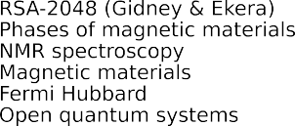
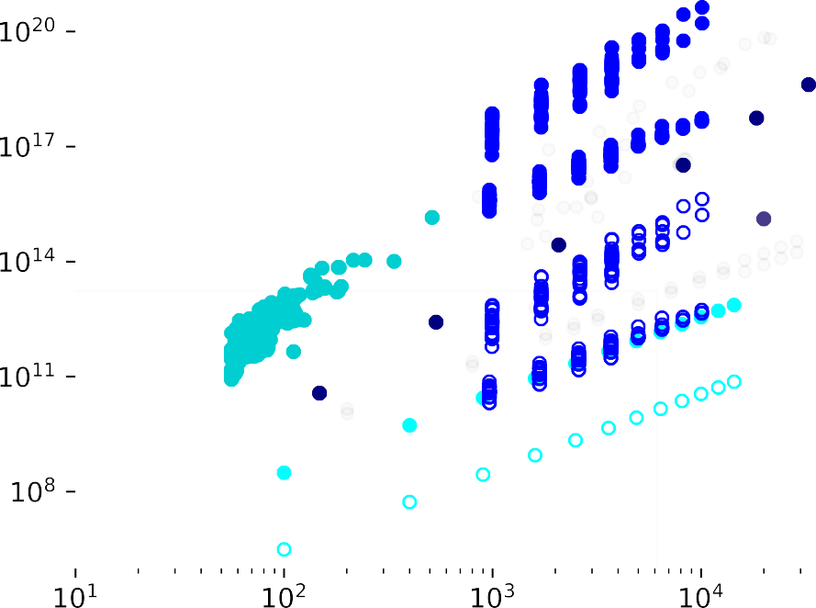
Resource reductions for quantum dynamics
What optimizations did we assume for quantum dynamics problems?
Spin System Optimizations
Analytic Trotter bounds are loose. Utilizing empirical bounds can reduce resource costs by orders of magnitude.¹
Application has very strict error tolerances. If these can be relaxed, resources can be lowered by a factor proportional to the error tolerance.¹
Fermi-Hubbard Optimizations
Improved mapping of fermions to qubits.²
Qubit count is nearly optimal for spin systems, but future work may enable further T-count reduction.
PNAS 115, 9456 (2018)
J. Chem. Th. Comp. 14, 5617 (2018)

Slide 24
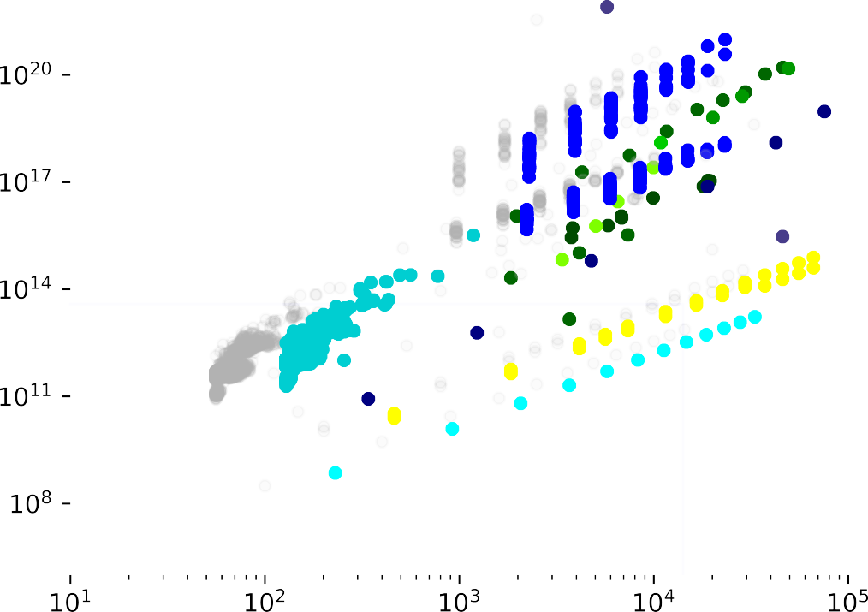
Architectural overhead and physical resource estimation
So far we’ve been talking about abstract logical architectures.
Any assumptions about real hardware push points to the right.
Architectural constraints shift all points (and sub-Shor region) up and to the right.

Slide 25
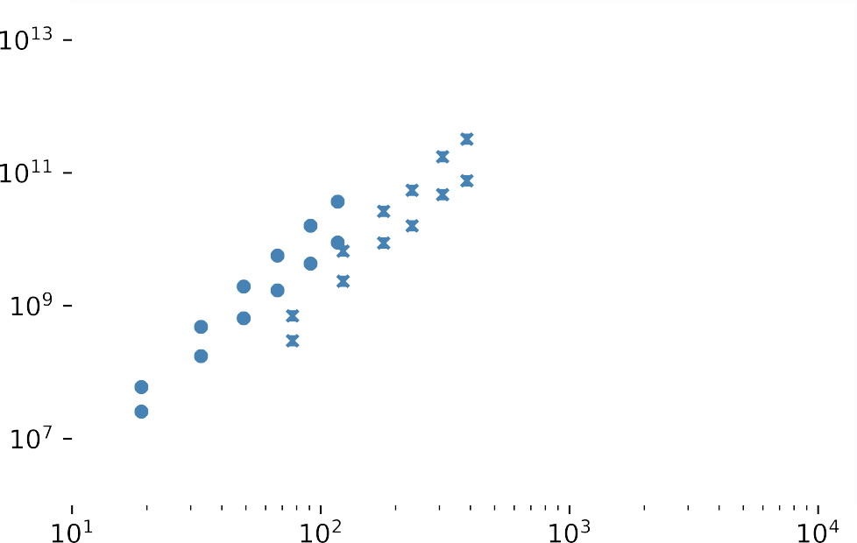
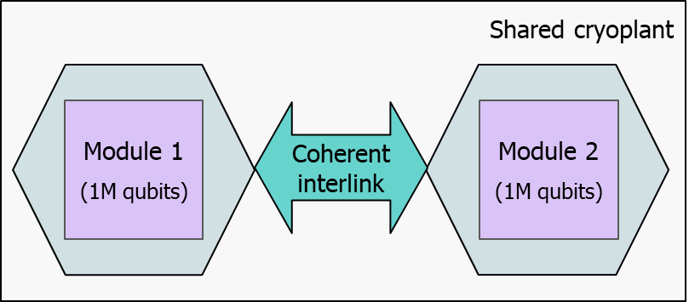
TA2 automated compilation tools
Fermi Hubbard Summary
Runtime: 7 minutes – 10 days
Code Distance: 17 – 21
Gidney-Ekera Summary
Runtime: 20 hours
Code Distance: 27
Automated compilation for small problems
Run on small-scale Fermi-Hubbard instances
Provide estimates of architectural overheads
Provide detailed physical resource estimates (runtime, power consumption, etc.)
Architecture: 2-fridge with bus
Architecture: Planar
~2.3x
Abstract resource estimates
Compiled resource estimates
~4x
Two-fridge architecture with coherent interconnect used for Rigetti physical resource estimates
TA2 compilers automate physical resource estimates

Slide 26
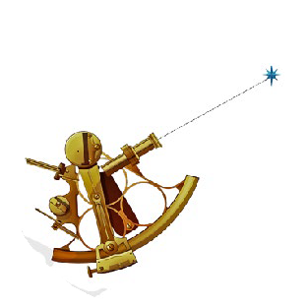
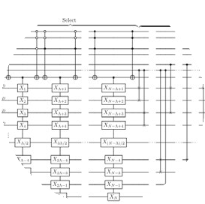
Future work in Phase 2 and beyond
QB Phase 2
Post-QB Work
Connect utility
to computer capabilities
Predict future performance of systems
Guide application development
$/T-gate for each application, including lower and upper bounds
Connect utility to benchmark score
Continue to develop and implement known algorithmic optimizations
Improve performance bounds of existing applications
Quantum algorithm development and optimization
Automated tools to speed up application development
Quantum architecture
co-design
New applications
Finalize Benchmarks
Robust Utility Estimates
Optimized Algorithms
Post-QB Opportunities

Slide 27
Underexplored Systems for Utility-Scale Quantum Computing (US2QC)

Slide 28
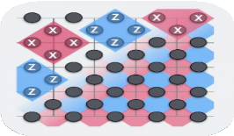
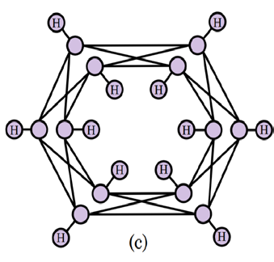
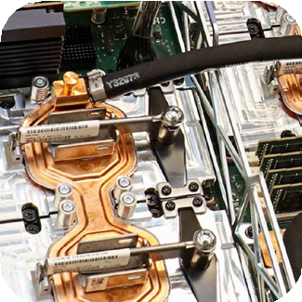
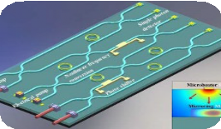
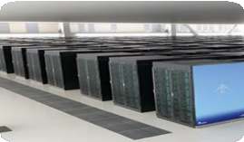
The US2QC program in one slide
US2QC Motivation:
Technical assumptions have made us vulnerable to surprise
Source: Niel de Beaudrap
Quantum computing is strategically important
Viable paths defy those assumptions
Source: U.S. Government
Source: PsiQuantum
US2QC Goal:
Reduce the danger of strategic surprise from underexplored quantum computing systems
US2QC Approach:
Evaluate designs for utility-scale quantum computers
Demonstrate enabling components and subsystems
Source: Ali Adibi, Ga Tech
Construct a prototype fault-tolerant quantum computer
Source: ORNL
Source: Fujitsu

Slide 29
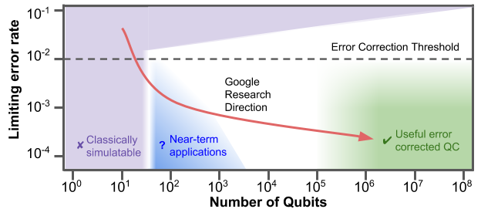
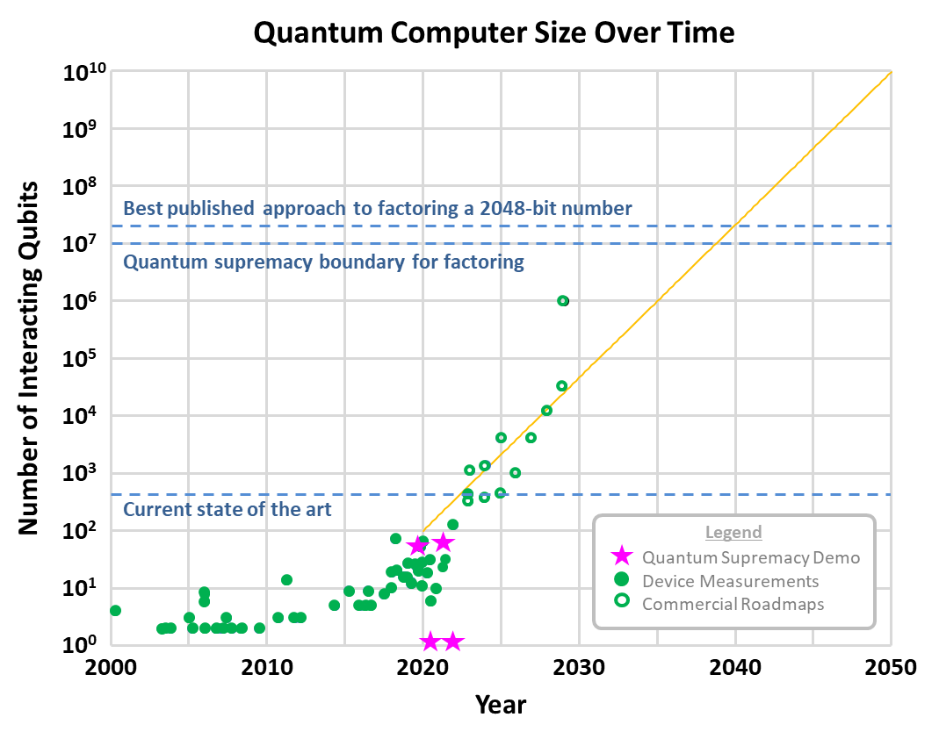
Technical assumptions have made us vulnerable to strategic surprise
Google Quantum Computing Planned Research Trajectory
Assumption → Logical Qubits are made of Physical Qubits
Conventional wisdom dictates that error-correction only works with physical qubits
Superconducting and ion-trap companies are incrementally improving physical qubits
Source: Google
Commercial Quantum Computer Roadmaps over Time
Assumption → Qubit Number, Fidelity are the Key Metrics
This model supports an initial goal of “quantum supremacy”
NISQ progress may not be directly relevant to Utility-Scale performance
These assumptions ignore quantum computing paradigms that are invalid in the noisy intermediate-scale (NISQ) regime
Source: DARPA

Slide 30
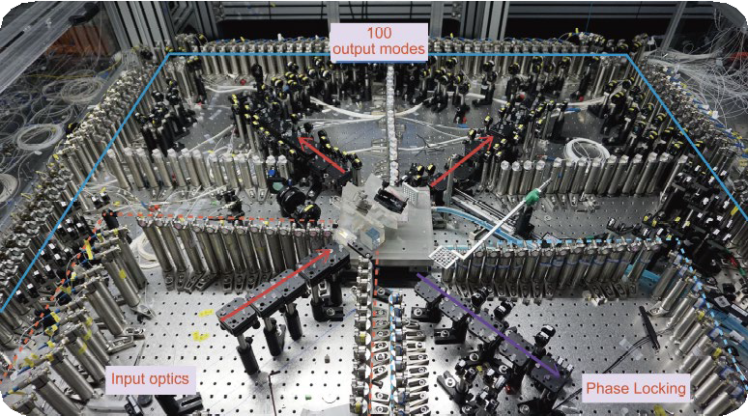
Critical concepts for the US2QC program
Utility-Scale Quantum Computer (USQC)
Fault-Tolerant Prototype (FTP)
← This
Source: Fujitsu
Utility-scale system
Not This →
Source: Fujitsu
Fault-tolerant prototype
Source: Science
A fault-tolerant quantum computer whose value exceeds its construction cost
A small fault-tolerant quantum computer that demonstrates that the utility-scale design is viable
US2QC will build Fault-Tolerant Prototypes and use them to validate designs for a Utility-Scale Quantum Computer

Slide 31
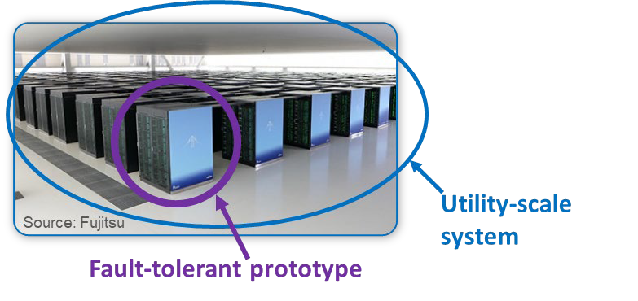
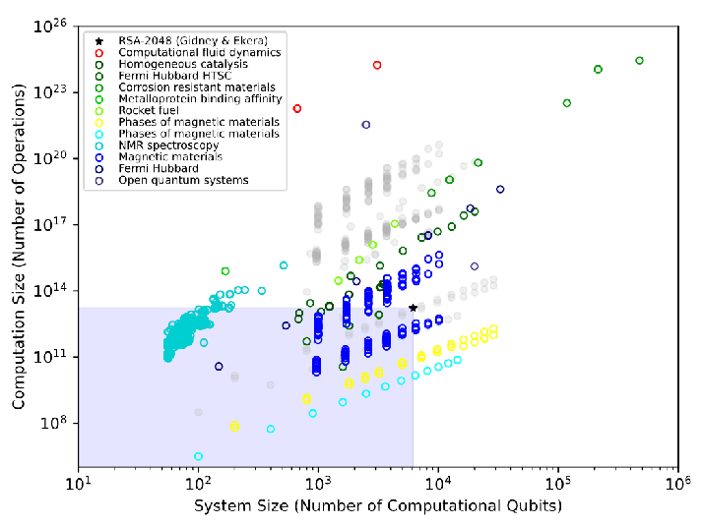
Program structure, part 1 → Architecture R&D
Utility-Scale Concept Review
Fault-Tolerant Prototype Requirements Review
Utility-Scale System Requirements Review
Architecture
R&D
Utility-Scale Concept
Fault-Tolerant Prototype Design
Utility-Scale System Design
High-Level Metrics
Establishes that the concept is viable
Sets Fault-Tolerant Prototype component requirements
Sets Utility-Scale System component requirements
High-Level Utility-Scale System (USQC) Requirements Derived from Applications Results
US2QC will build Fault-Tolerant Prototypes and use them to validate designs for a Utility-Scale Quantum Computer

Slide 32
Program structure, part 2 → Component R&D
Utility-Scale Concept Review
Fault-Tolerant Prototype Requirements Review
Utility-Scale System Requirements Review
Note: Phase transitions are performer-specific
Critical performer go/no-go points
Critical program deliverables
Architecture
R&D
Utility-Scale Concept
Fault-Tolerant Prototype Design
Utility-Scale System Design
Fault-Tolerant Prototype Final Design Review
Utility-Scale System Final Design Review
Component
R&D
Equipment Procurement
Fault-Tolerant Prototype Component R&D
Utility-Scale Subsystem R&D
Fault-Tolerant Prototype Intermediate Design Review
Utility-Scale System Intermediate Design Review
Paradigm-Specific Metrics
Examples for discrete photonics:
T&E Strategy
Integrated switch bandwidth, insertion loss
Waveguide/fiber-coupling loss
Source efficiency, purity, net heating
Detector efficiency, dark counts, speed
Component size/integrated density
Component yield
Decoder speed
I/O bandwidth
Cryosystem mean time between failures
Independent verification & validation
Don’t slow performers down
Build U.S. Government expertise
Real-time
Support U.S Government missions
← Evaluate hardware designs
And quantum architectures →
Sources: Optica, Ali Adibi, Jeffrey Tseng, CERN
Sources: Xanadu, Microsoft
Advanced Fault-Tolerant Prototype and Utility-Scale System designs can’t be completed without component R&D

Slide 33
Program structure, part 3 → Prototype R&D
Utility-Scale Concept Review
Fault-Tolerant Prototype Requirements Review
Utility-Scale System Requirements Review
Note: Phase transitions are performer-specific
Critical performer go/no-go points
Critical program deliverables
Architecture
R&D
Utility-Scale Concept
Fault-Tolerant Prototype Design
Utility-Scale System Design
Fault-Tolerant Prototype Final Design Review
Utility-Scale System Final Design Review
Component
R&D
Equipment Procurement
Fault-Tolerant Prototype Component R&D
Utility-Scale Subsystem R&D
Fault-Tolerant Prototype Intermediate Design Review
Utility-Scale System Intermediate Design Review
Prototype
R&D
Equipment Procurement
Fault-Tolerant Prototype Construction
Fault-Tolerant Prototype Delivery
Transition
A successful Fault-Tolerant Prototype should allow construction to begin on a Utility-Scale Quantum Computer immediately

Slide 34
Complete program structure with phases
Phase 0
USQC Concept
Phase 1
Fault-Tolerant Prototype Design
Phase 2
Component
Research and Development
Phase 3
Fault-Tolerant Prototype Construction
Transition
Utility-Scale Quantum Computer
Utility-Scale Concept Review
Fault-Tolerant Prototype Requirements Review
Utility-Scale System Requirements Review
Note: Phase transitions are performer-specific
Critical performer go/no-go points
Critical program deliverables
Architecture
R&D
Utility-Scale Concept
Fault-Tolerant Prototype Design
Utility-Scale System Design
Fault-Tolerant Prototype Final Design Review
Utility-Scale System Final Design Review
Component
R&D
Equipment Procurement
Fault-Tolerant Prototype Component R&D
Utility-Scale Subsystem R&D
Fault-Tolerant Prototype Intermediate Design Review
Utility-Scale System Intermediate Design Review
Prototype
R&D
Equipment Procurement
Fault-Tolerant Prototype Construction
Fault-Tolerant Prototype Delivery
Transition
U.S. Government-Targeted Application Exploration
Transition Partner Preparation
Transition

Slide 35
Test and Evaluation (T&E) approach
The T&E team is exploring key questions such as:
How sound is the quantum approach?
Can this organization build the quantum computer?
Can a utility-scale quantum computer be built?
Can this quantum computer be used effectively?
T&E comprises two general categories:
Broad System Evaluation
Deep, Targeted Analysis
Source: Autodesk
Source: Shutterstock
Source: PhyRevResearch
Source: Nature
Source: Nature

Slide 36
T&E System Evaluation Methodology
Roots (3)
USQC Physical Decomposition
What is a high-level description of a Utility Scale Quantum Computer?
What are all the components and sub-systems and how do they fit together?
What happens at the interfaces of those components and sub-systems?
USQC Functional Decomposition
How does the proposed USQC actually work?
How is it intended to be used?
What are its intended modes of operation and user interfaces?
Performer Processes
What processes, plans, and products does this team have in place?
Branches (16)
Leaves (50)
Example Branch Components and Subsystems
Example Leaf System description of the USQC including a graphic
depiction of the components and subsystems
How have they leveraged those (or different) processes, plans, products, in the past to come to their current USQC concept?
How will the team's processes, plans, products change or be leveraged in the future to burn down all the risks and actually be ready to start USQC construction?
System Evaluation → Provide a broad evaluation of the completeness and quality of concepts

Slide 37
System Evaluation Example
Prototypes/Generations
Design Processes Critical Technologies/Risks
R&D Plan
Trade Studies
Supply Chain Analysis
Performer Processes
1.1.1 | 1.1.2 | 1.1.3 |  | 1.2.1 | 1.2.2 |  | 1.3.1 | 1.3.2 | 1.3.3 |  | 1.4.1 | 1.4.2 | 1.4.3 | 1.4.4 |  | 1.5.1 | 1.5.2 | 1.5.3 |  | 1.6.1 | 1.6.2 | 1.6.3
Components & Subsystems
Physical Quantum Layer
Classical Computing Layer
Interfaces & Connectivity
Noise Models
Criteria
Greatly Exceeds
Exceeds
Meets
Partially Meets
Does not Meet
Physical Decomposition
2.1.1 | 2.1.2 | 2.1.3 |  | 2.2.1 | 2.2.2 | 2.2.3 | 2.2.4 |  | 2.3.1 | 2.3.2 | 2.3.3 |  | 2.4.1 | 2.4.2 |  | 2.5.1 | 2.5.2
Logical Layer
Modes of Operation
Applications
Algorithms
Software
Functional Decomposition
3.1.1 | 3.1.2 | 3.1.3 | 3.1.4 | 3.1.5 |  | 3.2.1 | 3.2.2 | 3.2.3 | 3.2.4 |  | 3.3.1 | 3.3.2 | 3.3.3 |  | 3.4.1 | 3.4.2 | 3.4.3 |  | 3.5.1 | 3.5.2 | 3.5.3

Slide 38
Test and Evaluation (T&E) team
DARPA has assembled a robust set of quantum computing and engineering experts to help understand and evaluate the US2QC quantum computer concepts
National Aeronautics and Space Administration (NASA)
Air Force Research Laboratory (AFRL)
Johns Hopkins Applied Physics Laboratory (JHU-APL)
Strengths
Strengths
Strengths
Quantum error correction
Systems engineering
Broad, deep quantum expertise
Classical High Performance Computing
Systems engineering
Broad quantum expertise
Oak Ridge National Laboratory (ORNL)
Los Alamos National Laboratory (LANL)
Applied Research Laboratory for Intelligence and Security (ARLIS)
Strengths
Strengths
Strengths
Data security expertise
Access to academics
Classical supercomputing
Ions / Photons
Applications
Quantum algorithms

Slide 39
Metrics and milestones
Deliverable | Timing | Purpose (See backup slides for detailed review requirements)
USQC Concept Review | Phase 0 | Confirm feasibility of the performer’s USQC concept Confirm the design concept is consistent with US2QC goals Review system conceptual baseline and initial system level specifications
FTP System Requirements Review | Phase 1 | Confirm that key FTP system performance metrics have been completely and properly identified Confirm all FTP components and sub-systems initial specification targets Confirm the FTP system concept is consistent with the US2QC goals
FTP System Intermediate Design Review | Phase 2 | Update FTP System baseline and component targets since the FTP Requirements Review Review the key FTP system performance metrics Provide a schedule and risk update, as well updates to targets based on experimental results
USQC Requirements Review |  | Update the USQC baseline design, and confirm USQC concept is consistent with 10-year time limit Confirm that key USQC system performance metrics have been completely and properly identified Confirm initial specifications targets for all components and sub-systems of the USQC
FTP System Final Design Review |  | Provide a final update of the FTP System design prior to entering Phase 3 system build Identify the current component and sub-system performance; link to system’s key performance metrics Provide a schedule and risk update for the Phase 3 system build
USQC Intermediate Design Review | Phase 3 | Update USQC System baseline; provide schedule and risk update Review key USQC system performance metrics Identify experimental progress on component and sub-system specs; update targets and changes
USQC Final Design Review |  | Provide a final update of the USQC System design to enable the execution of a USQC acquisition program Review the key USQC system performance metrics; provide schedule and risk update Identify the current component and sub-system performance including the FTP sub-system
USQC ROM Cost & Milestone Plan |  | Provide ROM Cost and Milestone plan for transition partner execution; details will be provided in invitation to submit to Phase 3
Deliver Fault-Tolerant Prototype |  | Deliver physical FTP to Govt site for independent verification and validation of all key system performance metrics; delivery must occur in time for realistic specified test plan to be executed
High-Level Utility-Scale System (USQC) Requirements Derived from Applications Results
Generic Performance Specifications
Area/Volume of system components and total system
Wall power requirement (for all systems)
Classical computing power required in steady state (in GFlops)
Cooling power at specified temperatures, in specified volumes
Required configuration and connectivity within and between quantum and classical sub-systems
Input/Output requirements for key systems
Space/time tradeoffs between total system size, gate depth, logical qubit number, etc.
Expected calibration time
Expected purchase price
Paradigm-Specific Performance Specifications (Example abridged list for a discrete photonics paradigm below)
Pump power, lambda | Pump BW, rep rate | Photon indistinguishability, purity | Switch power, speed | Loss per component
Yield per component | Min bend radius | Detector efficiency, dark counts, reset | Multi-pair probability | Sources per RSG
Circuit depth per photon | RSG state fidelity | Waveguide phase stability with temp | Local classical latency | Temp gradient on chip

Slide 40
If we succeed, what difference will it make?
Source: Shutterstock
National Security Impact Reduce Strategic Surprise
Economic Impact
Reveal First Utility-Scale Quantum Computers

Slide 41
www.darpa.mil

