Slide 1
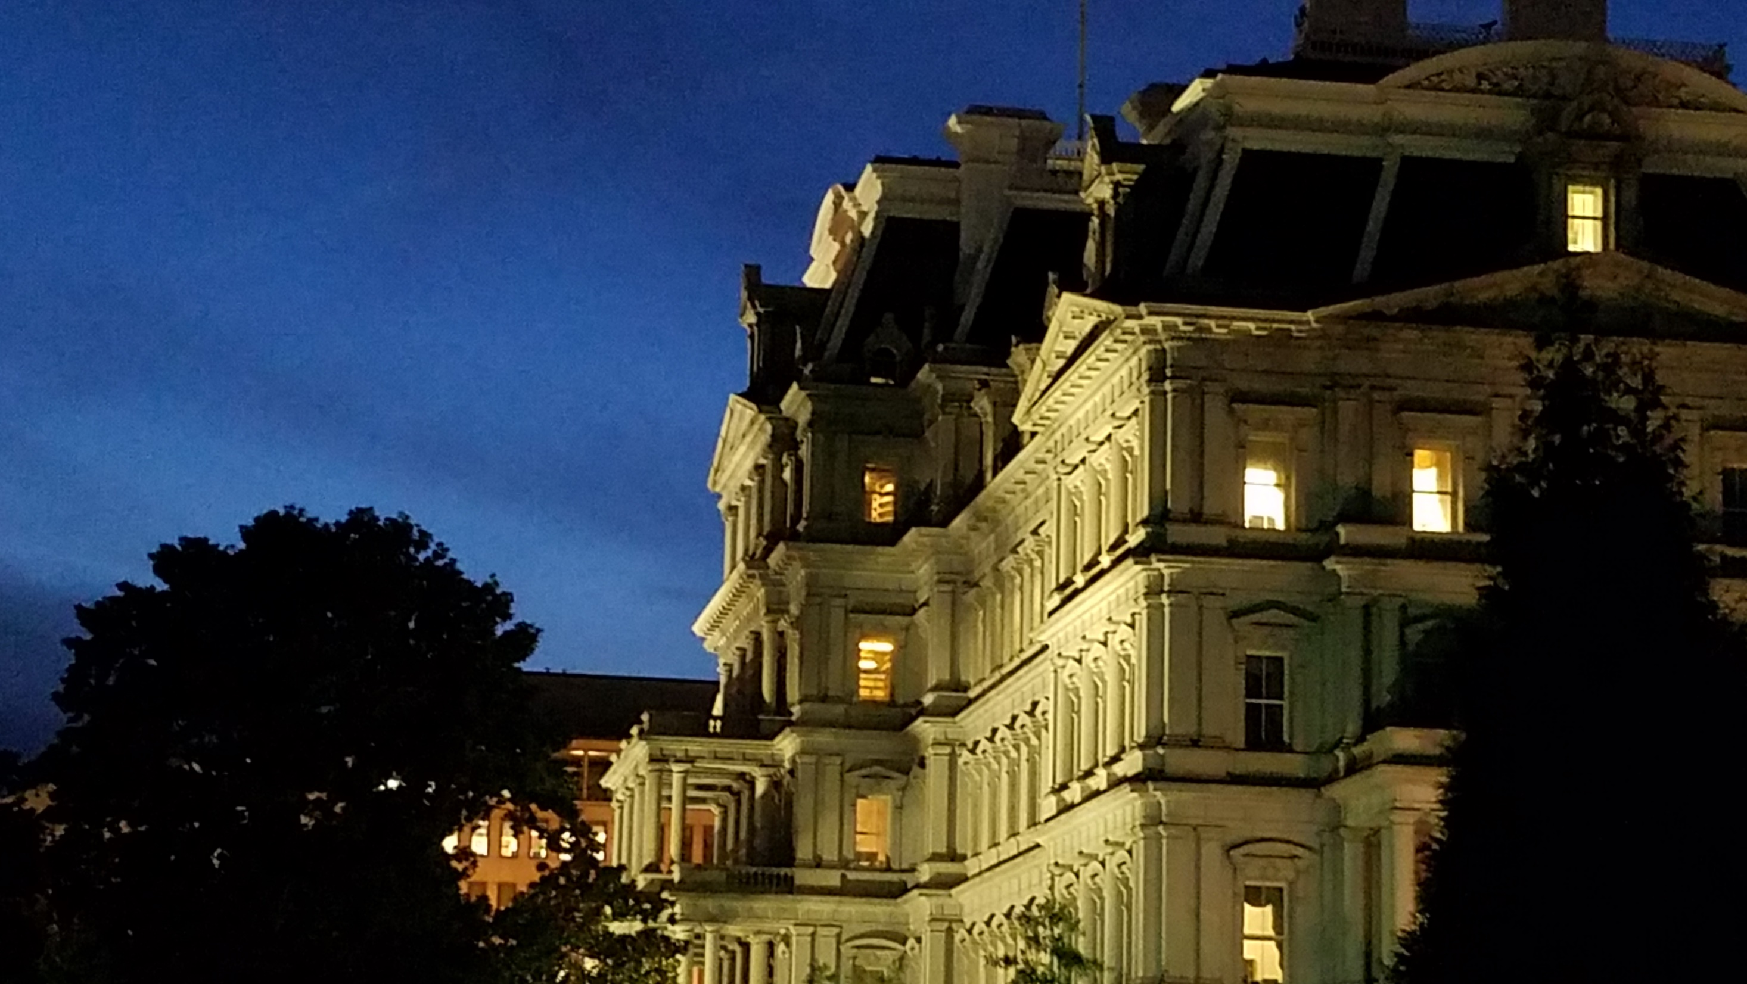

The National Quantum Initiative
Quantum For International Workshop
June 25, 2024
Dr. Gretchen Campbell
Director
National Quantum Coordination Office
Office of Science and Technology Policy
quantum.gov
whitehouse.gov/ostp
@WHOSTP
Office of Science and Technology Policy
OSTP works to harness the power of science, technology, and innovation to achieve America’s greatest aspirations.
National Quantum Coordination Office
Dr. Gretchen Campbell, Director
Dr. Brad Blakestad, Deputy Director
Dr. Tanner Crowder, Senior Policy Analyst
Dr. Thomas Wong, Consultant

Slide 2
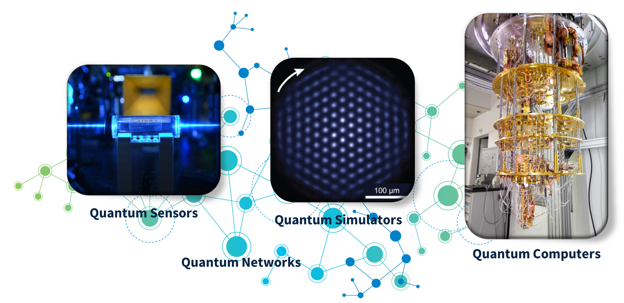
The National Quantum Initiative (NQI) Act
To provide for a coordinated Federal program to accelerate quantum research and development for the economic and national security of the United States.
Establishes a 10-year program to advance quantum research and technology applications and workforce development. Ensures continued leadership of the United States in QIST applications by:
Supporting R&D, demonstration, and application of QIST
Improving interagency planning and coordination of Federal R&D of QIST;
Maximizing the effectiveness of the Federal QIST research, development, and demonstration programs;
Promoting collaboration among the Federal Government, Federal laboratories, industry, and universities; and
Promoting the development of international standards for QIST security.
2

Slide 3























The National Quantum Initiative
White House COORDINATING BODIES
NSTC Subcommittee on Quantum Information Science (SCQIS)*
NSTC Subcommittee on Economic and Security Implications of Quantum Science (ESIX)**
NQI Advisory Committee (NQIAC)*
National Quantum Coordination Office (NQCO)*
Participating Agencies
Co-Chairs from:
Co-Chairs from:
Committee composed of experts from industry, academia, and Federal labs
Tasked with providing an independent assessment of and making recommendations for the NQI
Carries out the daily coordination activities needed by the NQI program
Serves as the POC on Federal civilian QIST activities.
Provides support to the subcommittees and NQIAC
Staffed by employees on detail from NIST, DOD, DOE, and NSA.
The NQI is a whole-of-government approach
* from National Quantum Initiative Act (PL 115-368) 2018
** from National Defense Authorization Act for FY’22 (PL 117-81)

Slide 4
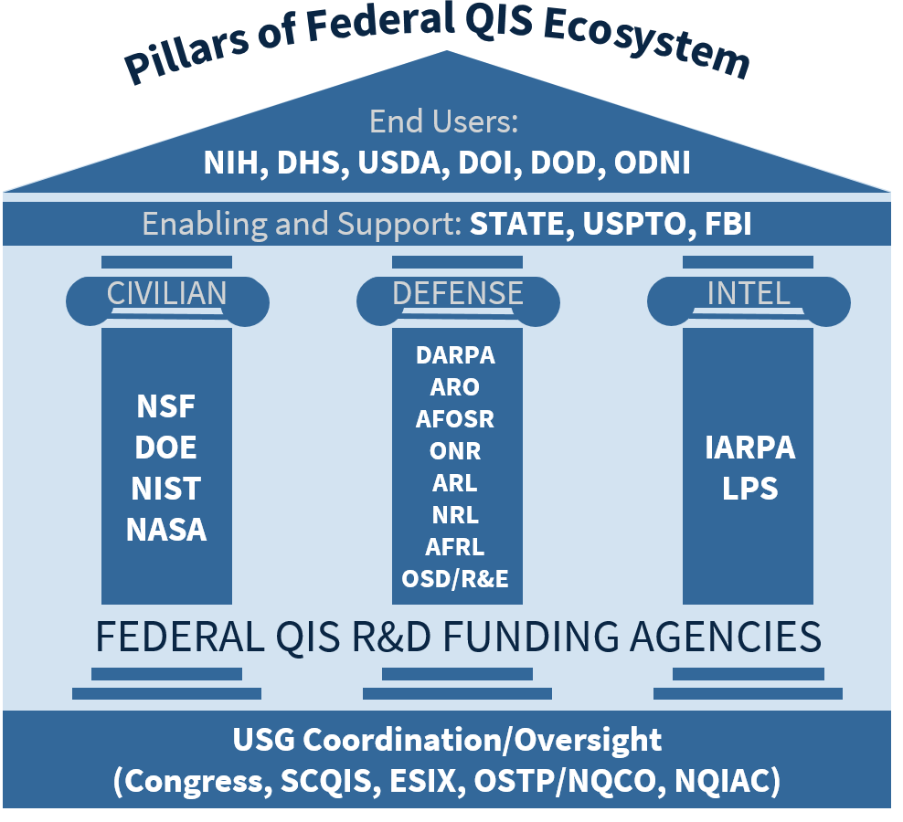
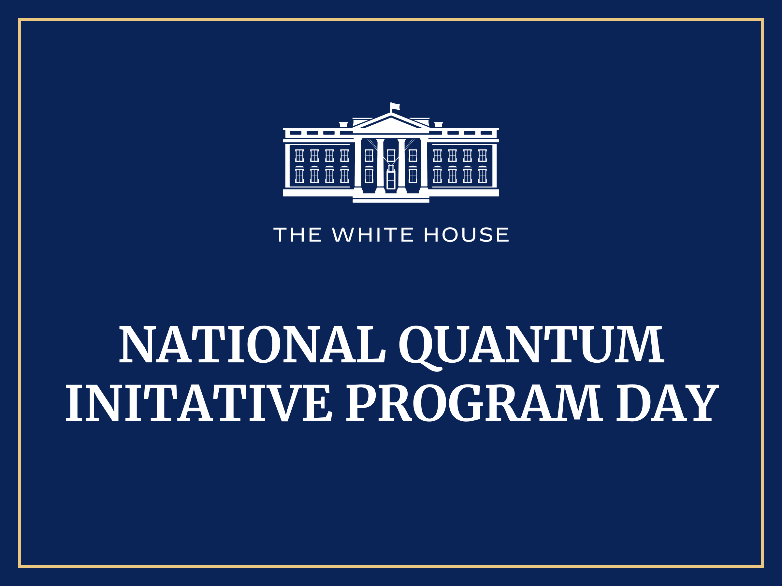
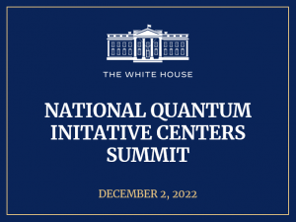
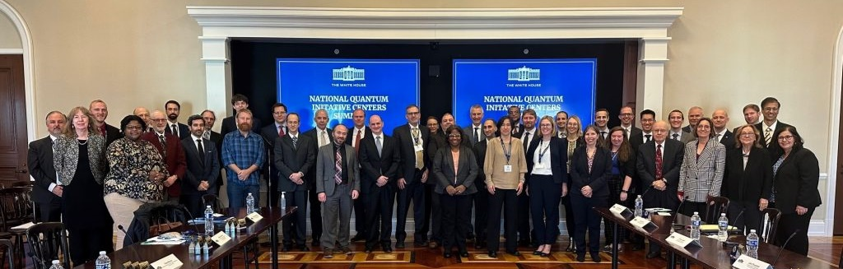
Federal Agencies in the QIS Ecosystem
Technical leaders from across the interagency compose the NSTC Subcommittees working groups that develop policy recommendations and aid in coordination.
CIVILIAN
National Science Foundation (NSF)
Department of Energy (DOE)
National Institute of Standards and Technology (NIST)
National Aeronautics and Space Administration(NASA)
DEFENSE
Defense Advanced Research Projects Agency (DARPA)
Army Research Office (ARO)
Air Force Office of Scientific Research (AFOSR)
Office of Naval Research (ORN)
Army Research Lab (ARL)
Naval Research Lab (NRL)
Air Force Research Lab (ARFL)
Office of the Secretary of Defense/Research and Engineering (OSD/R&E)
INTELLIGENCE
Intelligence Advanced Research Projects Activity (IARPA)
Laboratory For Physical Sciences (LPS)
END USERS
National Institutes of Health (NIH)
Department of Homeland Security (DHS)
United States Department of Agriculture (USDA)
United States Geological Survey (DOI/USGS)
Department of Defense (DOD)
Office of the Director of National Intelligence (ODNI)
ENALBING AND SUPPORT
Federal Bureau of Investigation (FBI)
U.S. Patent and Trade Office (USPTO)
Department of State (STATE)

Slide 5
National Science and Technology Council (NSTC)
Quantum Subcommittees
Subcommittee on
Quantum Information Science (SCQIS)
Subcommittee on Economic and Security Implications of Quantum Science (ESIX)
Co-Chaired by OSTP, DOE, NSF, and NIST
Responsibilities from the NQI Act:
͏coordinate QIST research / information sharing
establish goals and priorities of the NQI
assess and recommend Federal infrastructure needs
assess the status, development, and diversity of the U.S. QIS workforce
assess the global outlook for QIS R&D efforts
evaluate opportunities for international cooperation with strategic allies on R&D in QIST
propose a coordinated interagency budget for the NQI ensure the maintenance of a balanced QIS research portfolio and an appropriate level of research effort
Co-Chaired by OSTP, DOE, NSA, and DOD
Responsibilities from the NQI Act:
͏track investments of the Federal Government in QIS R&D
review and assess any economic or security implications
review and assess any counterintelligence risks or other foreign threats
recommend goals and priorities to address any counterintelligence risks or other foreign threats
assess the export of technology associated with QIS
recommend investment strategies in QIS that advance the economic and security interest of the United States;
recommend appropriate protections to address counterintelligence risks or other foreign threats
ensure Federal investments in QIS R&D balance scientific progress and potential economic and security implications
National Quantum Coordination Office
Currently staffed by quantum information scientists on detail from NSA, NIST, DOD, and DOE (and previously NSF)
Oversee interagency coordination of the NQI, ensure coordination of collaborative ventures, conduct public outreach, promote access
Provides technical and administrative support to the above committees an the NQI Advisory Committee
Serve as the point of contact on Federal civilian QIST activities

Slide 6
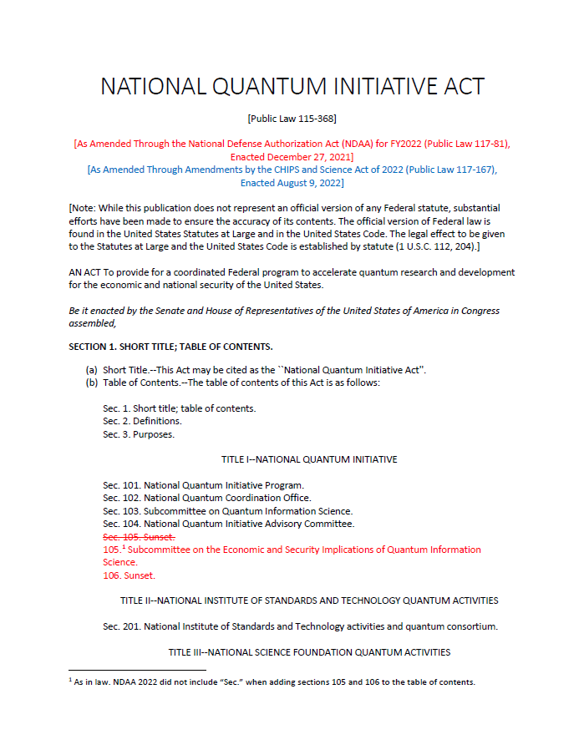
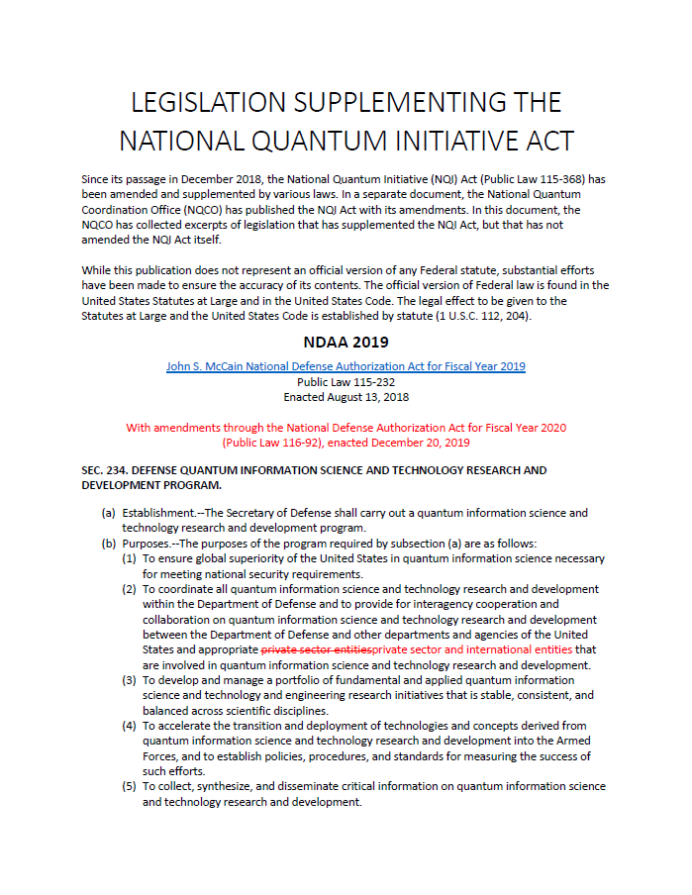
Quantum Legislation
National Quantum Initiative Act
Established December 2018, amended by the
National Defense Authorization Act (NDAA) for Fiscal Year (FY) 2022
CHIPS and Science Act of 2022
Established
Coordinating/oversight bodies
NIST QIS research, standards, launch industry consortium
NSF QIS research and education programs and Centers
DOE QIS research programs and Centers, quantum networking program, and user access program
Available on
quantum.gov
Supplementing Legislation
NDAAs
  FY 2019: DOD QIS program
  FY 2020: DOD QIS Centers, Coordinate efforts with broader NQI
  FY 2022: Dual-use quantum technologies
CHIPS and Science Act of 2022
  NSF TIP directorate, key technology focus areas include QIS
  NSF quantum workforce report and education program
  Microelectronics Centers should coordinate with QIS Centers

Slide 7
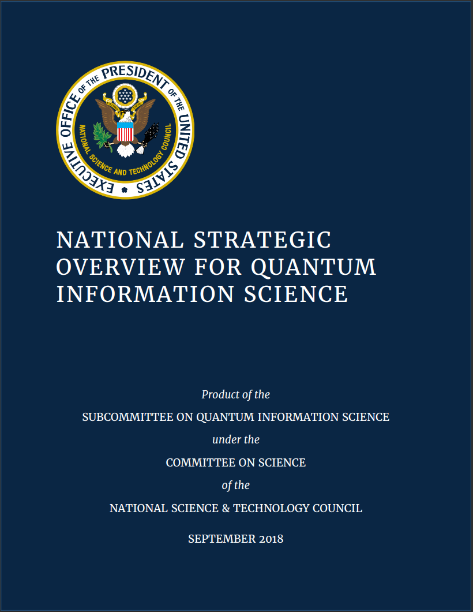
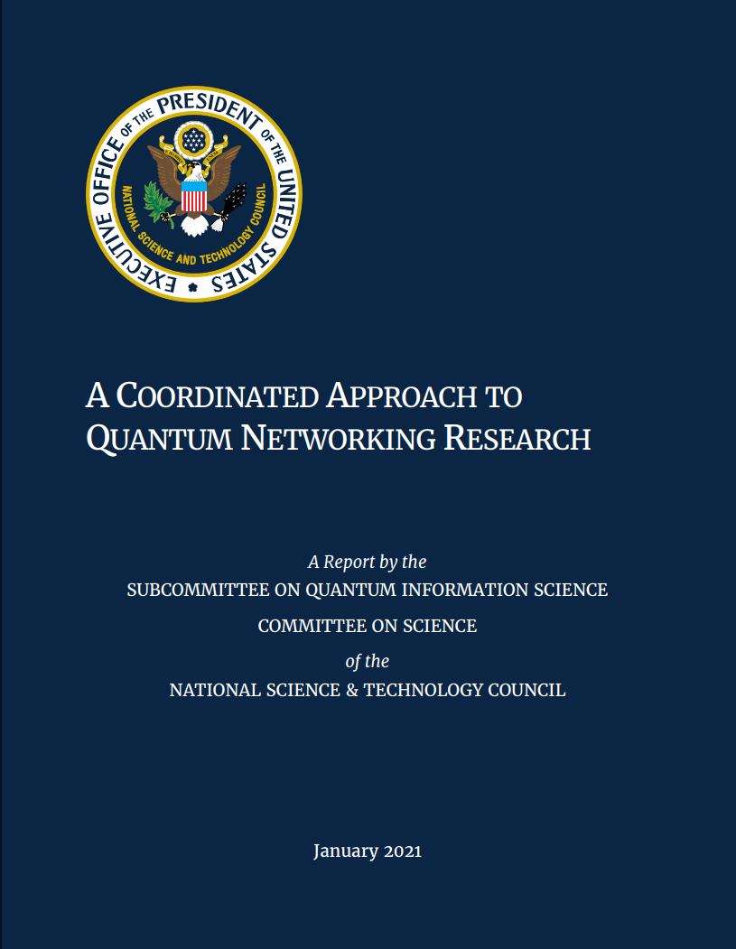
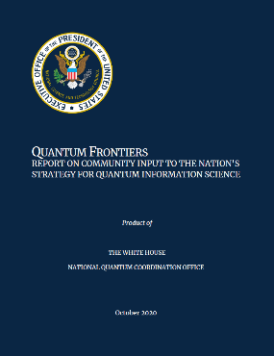
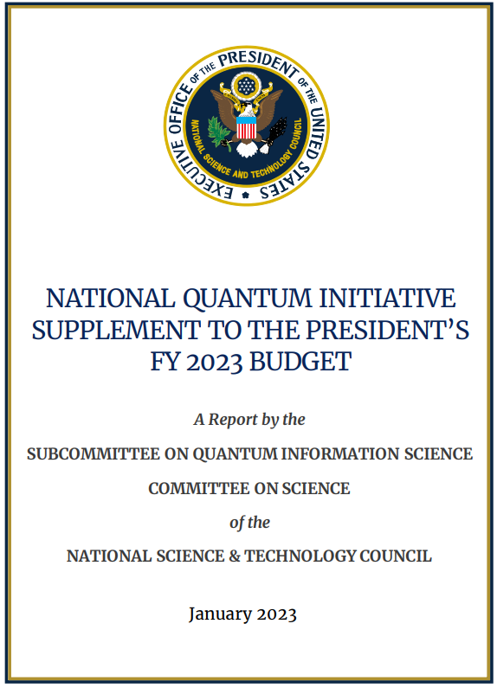
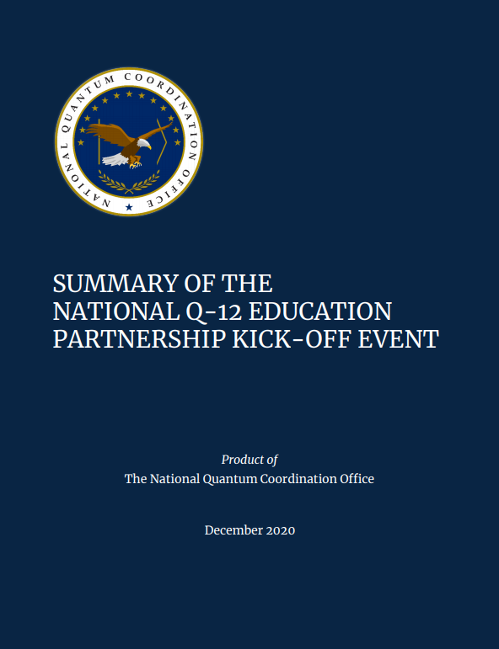
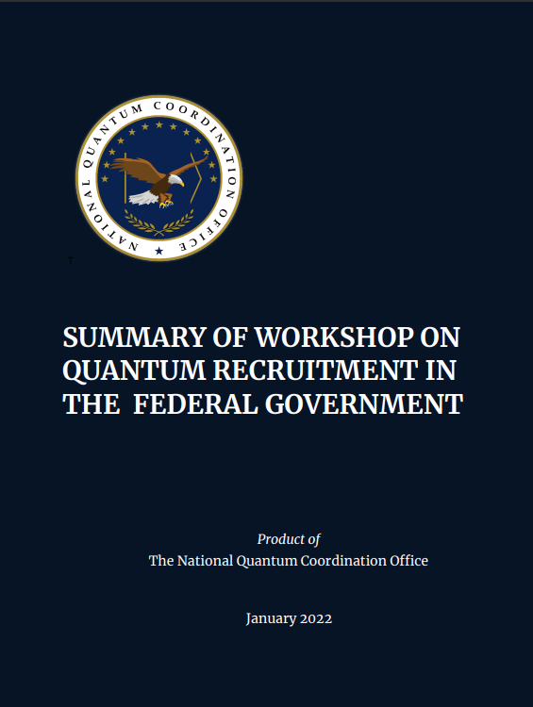
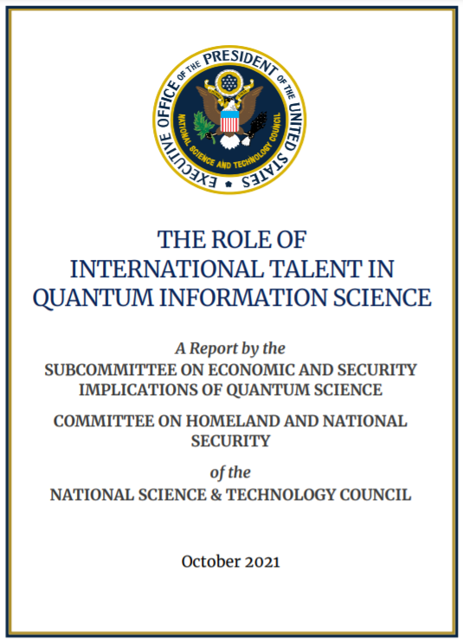
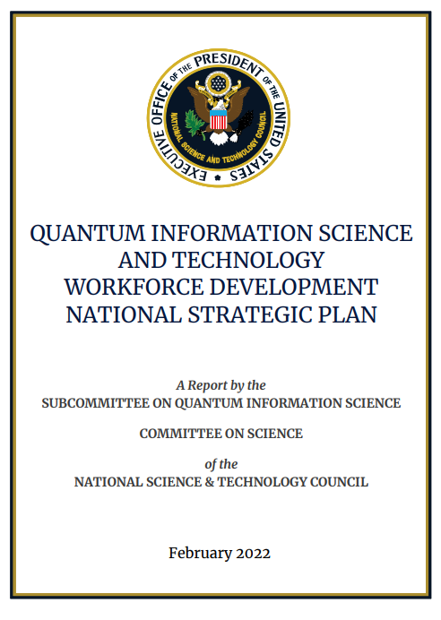
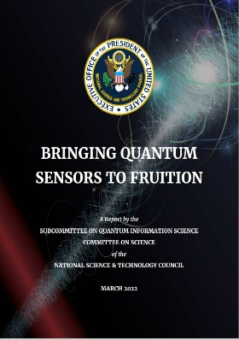
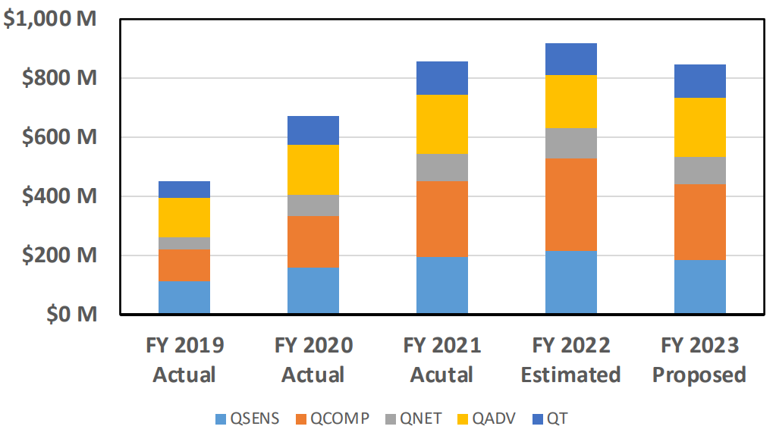
U.S. National Strategy for QIS
Six Policy Pillars:
Take a science-first approach
Provide the key infrastructure
Build a quantum-capable and diverse workforce
Nurture the nascent quantum industry
Balance economic and national security
Continue to develop international collaboration and cooperation
Find all our strategy documents on quantum.gov
7

Slide 8
U.S. National Strategy for QIS
͏Getting the science right by understanding the applications and timelines by which QIST will benefit our society, and roadblocks we must overcome to get there;
͏Enhancing competitiveness by accelerating technology development toward useful economic and mission applications while also protecting our national security; and
͏Enabling people by building the necessary talent pipeline and ensuring that this field creates new opportunities for all Americans.
Find all our strategy documents on quantum.gov
8

Slide 9
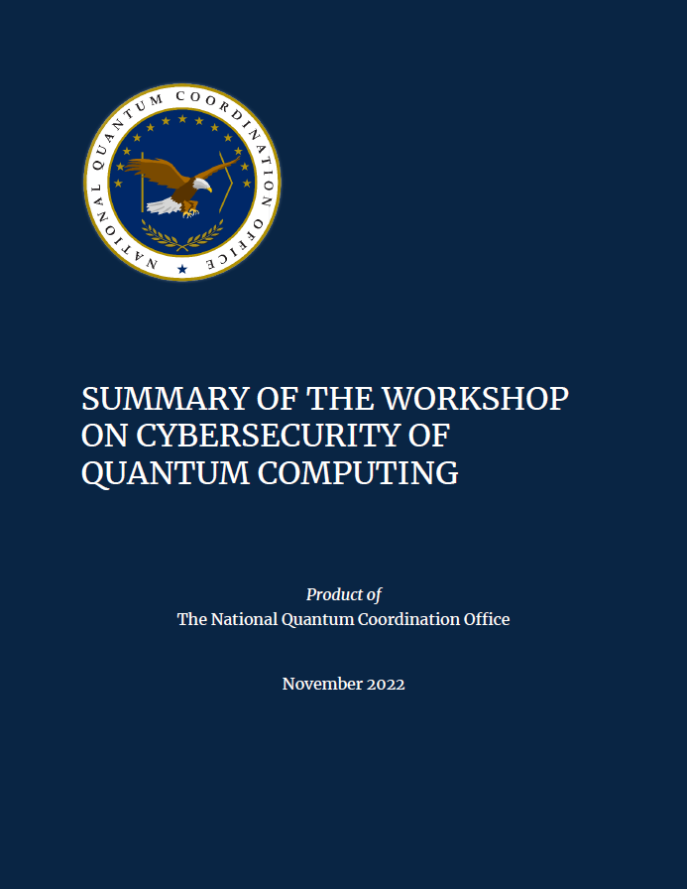
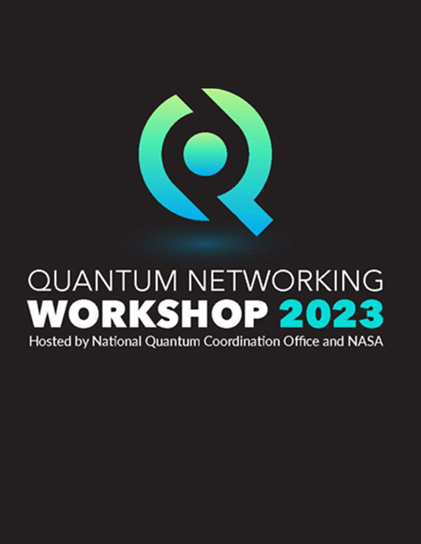
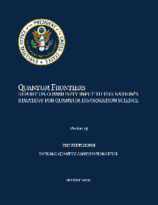
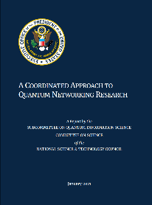
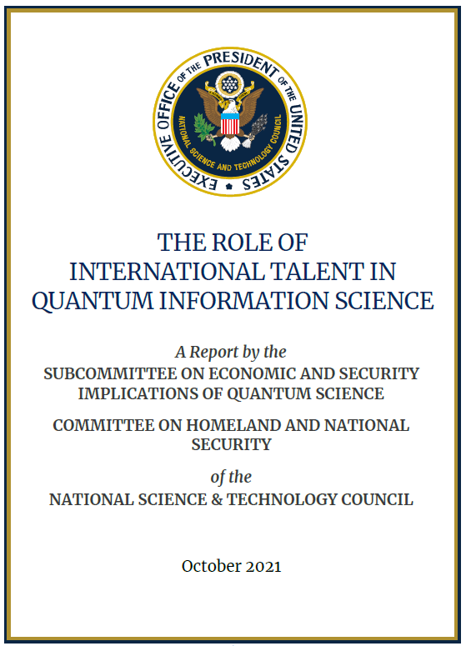
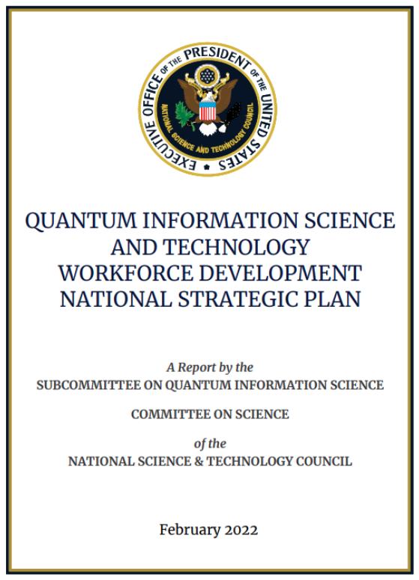
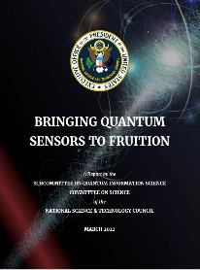
Getting the Science Right - Augmenting the National Strategic Overview
Quantum Frontiers
QIST to Benefit Society
Building Quantum Engineering
Materials Science for QIST
Quantum Mechanics using Quantum Simulations
QIST for Precision Measurement
Quantum Entanglement for New Applications
Quantum Errors
The Universe through Quantum Information
Quantum Networking
TR 1: Continue Research on Use Cases
TR 2: Prioritize Cross-Beneficial Core Components
TR 3: Improve Classical Capabilities
TR 4: Leverage “Right-Sized” Quantum Testbeds
PR 1: Increase Interagency Coordination
PR 2: Establish Timetables for R&D Infrastructure
PR 3: Facilitate International Cooperation
Quantum Sensing
QIST R&D leaders should partner with end-users to raise the TRL of new quantum sensors
Agencies using sensors should jointly test quantum prototypes with QIST R&D leaders
Develop broadly applicable components and subsystems
Streamline tech transfer and acquisition practices

Slide 10
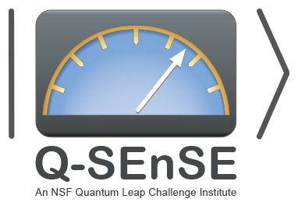















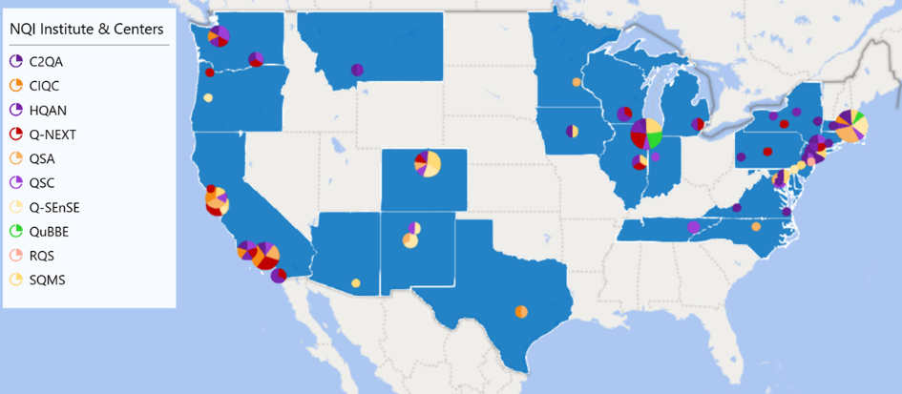
Getting the Science Right: Centers
5 NSF Quantum Leap Challenge Institutes
CIQC: Challenge Institute for Quantum Computation
Q-SEnSE: Quantum Systems through Entangled Science and Engineering
HQAN: Hybrid Quantum Architectures and Networks
QuBBE: Quantum Sensing for Biophysics and Bioengineering
RQS: Institute for Robust Quantum Simulation
5 DOE National QIS Research Centers
Q-NEXT: Next Generation Quantum Science and Engineering
C2QA: Co-design Center for Quantum Advantage
SQMS: Superconducting Quantum Materials and Systems Center
QSA: Quantum Systems Accelerator
QSC: The Quantum Science Center
4 DOD/IC QIS Research Centers
Air Force Research Laboratory
Naval Research Laboratory
Army Research Laboratory
Laboratory for Physical Sciences (LPS)
Qubit Collaboratory (LQC)
+ Core Research Programs
U.S. National Quantum Centers and Institutes

Slide 11
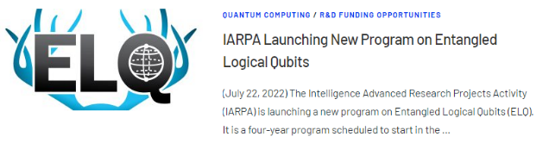
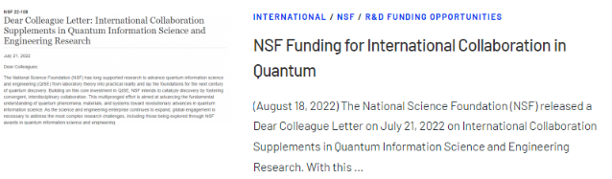
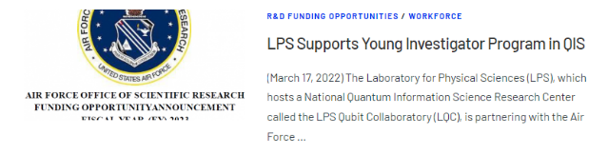
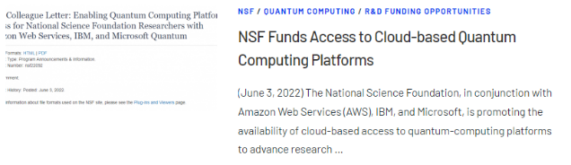
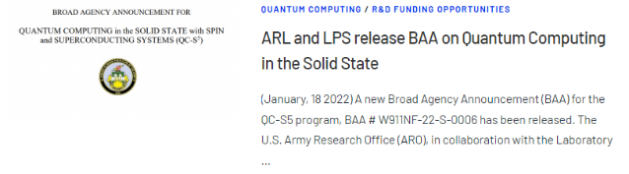
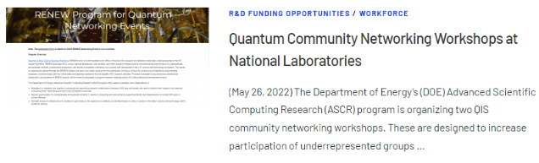
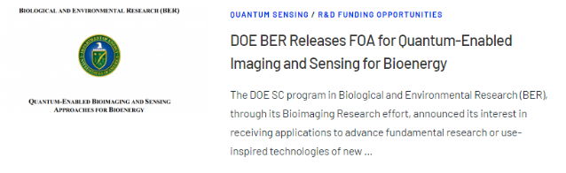
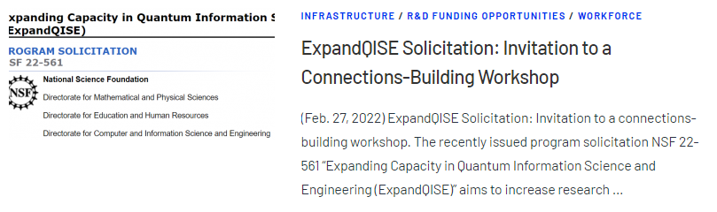

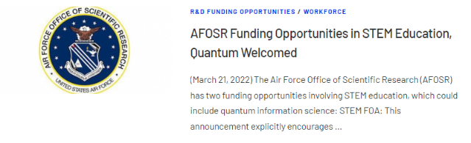
Getting the Science Right: Programs and Workshops
Some quantum.gov news posts

Slide 12
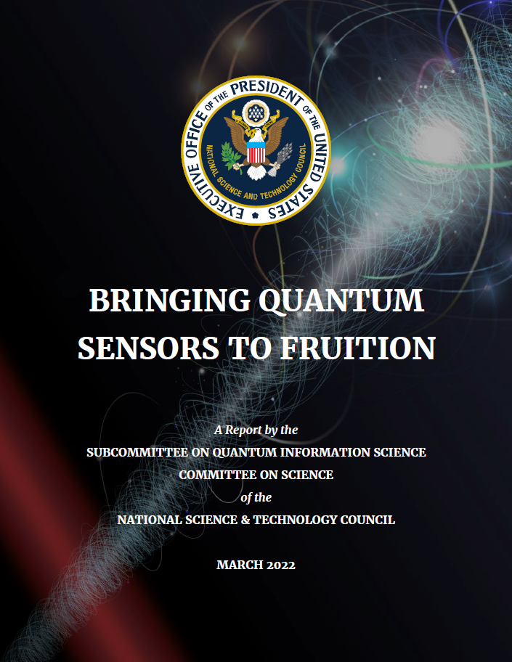



Getting the Science Right:
Bringing Quantum Sensors to Fruition
Synopsis of Program:
The Quantum Sensing Challenges for Transformational Advances in Quantum Systems (QuSeC-TAQS) program supports interdisciplinary teams of three (3) or more investigators to explore highly innovative, original, and potentially transformative research on quantum sensing. The QuSeC-TAQS program supports coordinated efforts to develop and apply quantum sensor systems, with demonstrations resulting in proof of principle or field-testing of concepts and platforms that can benefit society. The QuSeC-TAQS program aligns with recommendations articulated in the strategy report, Bringing Quantum Sensors to Fruition, that was produced by the National Science and Technology Council Subcommittee on Quantum Information Science, under the auspices of the National Quantum Initiative.
Available on quantum.gov
12

Slide 13
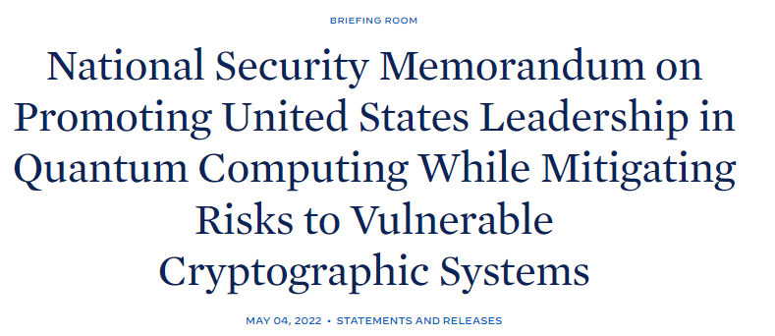
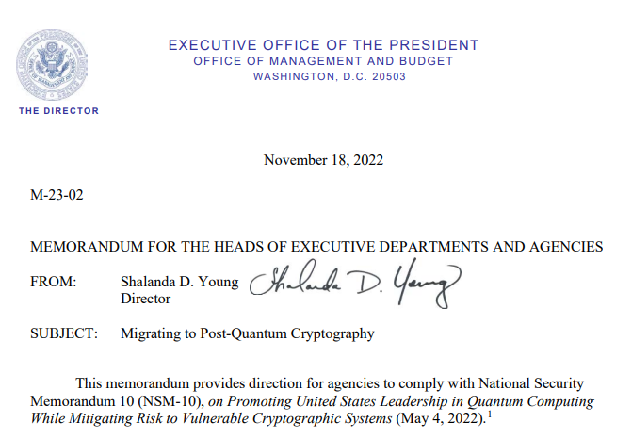
Enhancing Competitiveness: NSM-10
National Security Memorandum 10 (NSM-10)
Sec. 1: Policy
Quantum computers hold the potential to drive innovations across the American economy
Yet alongside its potential benefits, quantum computing also poses significant risks to the economic and national security of the United States.
In order to balance the competing opportunities and risks of quantum computers, it is the policy of the United States (1) to maintain United States leadership in QIS; and (2) to mitigate the threat of CRQCs through a timely and equitable transition to PQC.
Sec. 2: Promotion
Sec. 3: Mitigating Risks to Encryption
U.S. must prioritize the timely and equitable transition of cryptographic systems to QRC.
Series of deadlines for federal agencies to support the transition
Sec. 4: Protecting U.S. Technology
U.S. Gov must work to safeguard relevant quantum R&D and intellectual property (IP) and to protect relevant enabling technologies and materials.
Agencies responsible for either promoting or protecting QIS and related technologies should understand the security implications of QC
U.S. should ensure the protection of U.S.‑developed quantum technologies from theft by our adversaries.
R&D: encourage transformative and fundamental scientific discoveries through investments in core QIS research programs.
Workforce: foster the next generation of scientists and engineers with quantum-relevant skill sets, including those relevant to QRC.
Partnerships: promote domestic partnerships and professional and academic collaborations with overseas allies and partners.
Central to this effort will be an emphasis on cryptographic agility, to reduce the transition time and to allow for updates for future cryptographic standards.
Pursue a whole-of-government/society strategy to harness the economic and scientific benefits of QIS, and the security enhancements provided by QRC.
OMB Memo on Complying with NSM-10

Slide 14
Enhancing Competitiveness: Security
Workshop on Cybersecurity of Quantum Computing
Supported by NSF & OSTP
Brought together roughly 40 experts from the cybersecurity and quantum computing communities to explore topics such as:
  Protecting quantum computing intellectual property
  Mechanisms to ensure that quantum computers are not used for illicit purposes
  Opportunities for research on the cybersecurity of quantum computers
Participants identified research areas to address challenges that included:
  Secure large-scale control systems
  Distributed high-performance quantum computing
  Attack vectors on different types of quantum computers
  Formal methods for safe and secure quantum computing systems
  Multi-layered instrumentation framework
  Tools for service providers to verify quantum algorithms

Slide 15
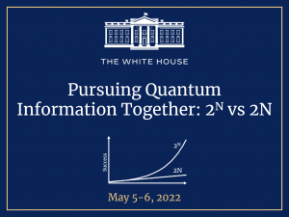
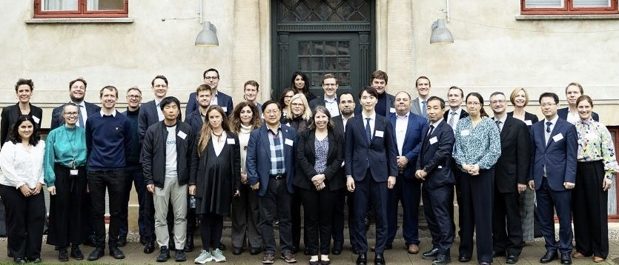
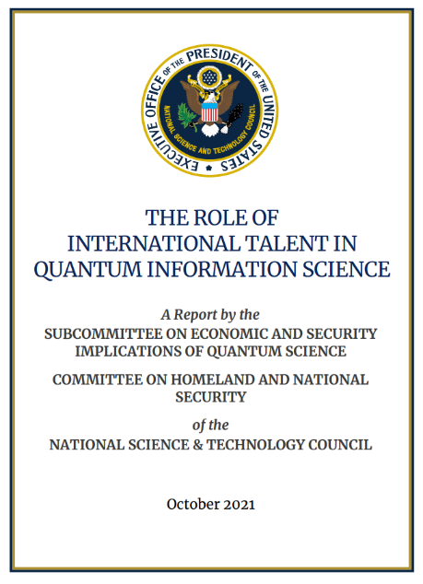
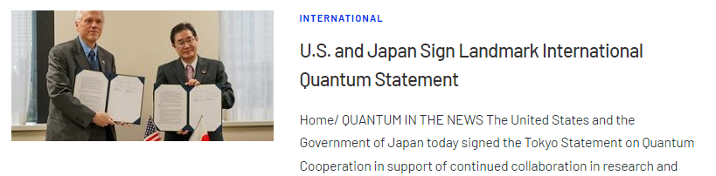
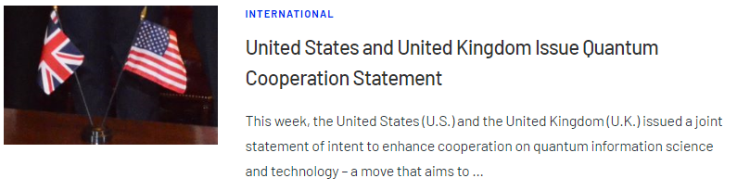
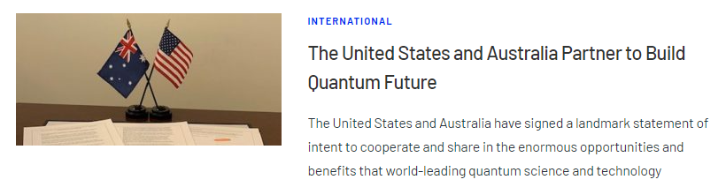
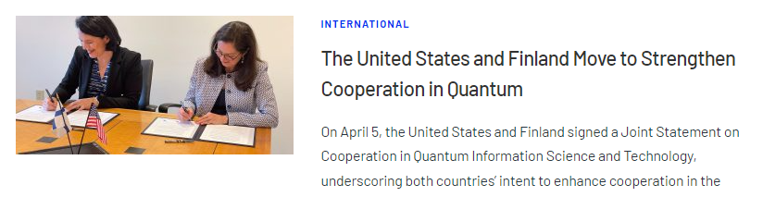
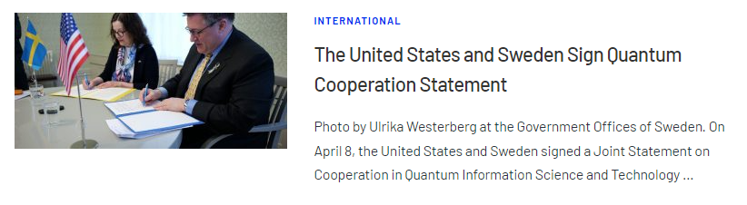
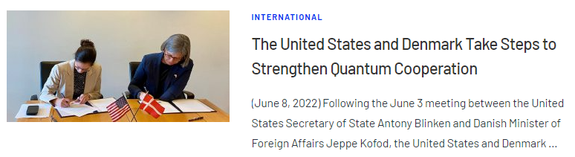
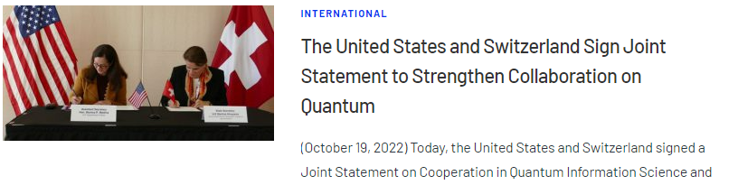
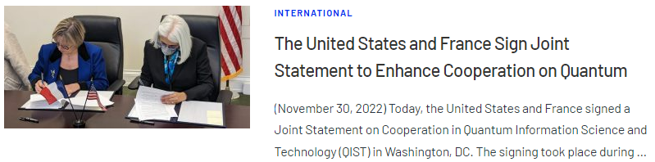


Enhancing Competitiveness: International Cooperation
As new technologies continue to evolve, we’ll work together with our democratic partners to ensure that new advances in areas from biotechnology, to quantum computing, 5G, artificial intelligence, and more are used to lift people up, to solve problems, and advance human freedom – President Biden
Good faith cooperation underpinned by shared values.
Promoting jointly funded and cooperative QIST R&D.
Understand trajectories in QIST.
Enabling opportunities for global market and supply chain
Creating regular bilateral and multilateral opportunities
Promoting multidisciplinary research, including the exchange of people.
Notes:
FACT SHEET: Biden-⁠Harris Administration Actions to Attract STEM Talent and Strengthen our Economy and Competitiveness

Slide 16


EntanglementExchange.org
Entanglement Exchange Links Quantum Researchers Across Twelve Nations
New website is a portal for international exchange opportunities in quantum information science
November 30, 2022
Australia, Canada, Denmark, Finland, France, Germany, Japan, the Netherlands, Sweden, Switzerland, the United Kingdom, and the United States are proud to launch the Entanglement Exchange, a portal for highlighting international exchange opportunities for students, postdocs, and researchers in quantum information science (QIS).
The Entanglement Exchange Celebrates World Quantum Day and Welcomes the Republic of Korea
Happy World Quantum Day from the Entanglement Exchange!
April 14, 2023
Celebrated annually on April 14th, World Quantum Day is an international, grassroots effort to promote the public understanding of quantum science and technology around the world. Activities include public lectures, social media campaigns, classroom activities, laboratory tours, and more. Each of the nations in the Entanglement Exchange is engaged in this larger, worldwide celebration.

Slide 17


Enabling People: Federal Workforce Activities in QIS
Available on quantum.gov

Slide 18

















Enabling People: Inspire + Education + Experiences => Careers
INSPIRE
EDUCATION AND TRAINING
ACCESSIBLE EXPERIENCES AND CAREERS
Teaching Resources
K-12 Framework for Phys, CS, Math & Chem
Workshop on Gaps in Postsecondary Quantum Education and Training
This is Quantum Video
100k Views
Search:
This is quantum q12
Public Outreach
100’s of teachers
20k+ students

Slide 19

National Quantum Initiative Advisory Committee
Established by Sec. 104 of the NQI Act
Advises the—
  President
  NSTC Subcommittee on Quantum Information Science (SCQIS)
  NSTC Subcommittee on Economic and Security Implications of Quantum Science (ESIX)
Conducts independent assessments of the NQI, including any recommendations for improvements, through reports submitted to the President and appropriate committees of Congress
NQIAC & NQCO

Slide 20

NQIAC Report: Renewing the NQI
First meeting was in December 2022
Three Subcommittees met for six months hearing from experts across the nation
Publish report in June 2023
Met in November 2023 with a focus on quantum networking
https://www.quantum.gov/about/nqiac/
Recommendations:
Reauthorize and appropriate the NQI Act
Expand research
Fund industry-led partnerships
Invest in equipment and infrastructure
Promote international cooperation
Promote and protect U.S. QIST R&D
Strengthen supply chains
Develop domestic talent
Attract and retain foreign talent

Slide 21


NQI Reauthorization
The NQI Act authorized several activities for five years, which expired on September 30, 2023
Interagency Input
National Quantum Initiative Advisory Committee
1. QIS Program Day 2022
2. OSTP/NQCO coordinated an interagency process (through OMB) for recommending policies to enhance the NQI Act, which were submitted to relevant committees of Congress
NQIAC & NQCO
Community Input
Experts representing industry (small and large), academia, and Federal laboratories
Report on Renewing the NQI: Recommendations for Sustaining American Leadership in QIS
  3 Findings
  4 Overarching Recommendations
  9 Detailed Recommendations
June 2023 report available on quantum.gov

Slide 22





NQI Reauthorization:
House Committee on Science, Space, and Technology
June 7, 2023: Full hearing on Advancing American Leadership in Quantum Technology
  “The purpose of this hearing is to evaluate the state of quantum research, development, and technology (RD&T) in the United States. The hearing will serve as an opportunity to review and discuss the first five years of the National Quantum Initiative Act (NQIA), the economic value of quantum science and its applications, the national security importance of developing quantum capabilities, and what policies should be considered in the next five years. The hearing will help inform legislation to reauthorize NQIA programs that expire on September 30, 2023.”
November 3, 2023: Chairman Lucas and Ranking Member Lofgren introduced the NQI Reauthorization Act
November 15, 2023: Full committee markup of NQI Reauthorization Act
  Amendment in the Nature of a Substitute
  18 additional amendments
  All passed by voice vote
November 29, 2023: Passed unanimously out of committee
Available at science.house.gov

Slide 23



QIS is an Administration Priority
“As new technologies continue to evolve, we’ll work together with our democratic partners to ensure that new advances in areas from biotechnology, to quantum computing, 5G, artificial intelligence, and more are used to lift people up, to solve problems, and advance human freedom.” – President Biden, Remarks Before the 76th Session of the United Nations General Assembly, September 21, 2021
“Quantum computing has the potential to transform everything, from how we create new medicines to how we power artificial intelligence and cybersecurity. It’s technology that is vital to our economy and equally important to our national security.” – President Biden, Remarks on the CHIPS and Science Act, October 6, 2022
“This increase in research and development funding is going to ensure that the United States leads the world in the industries of the future: quantum computing, to artificial intelligence, to advanced biotechnology.” – President Biden, Signing of the CHIPS and Science Act, August 9, 2022

Slide 24

QIS is an Administration Priority
R&D Priorities for the President’s FY 2025 Budget
Joint Memo from the Director of OMB and Director of OSTP
Lead the world in maintaining global security and stability in the face of immense geopolitical changes and evolving risks. […]
Advance critical and emerging technology areas, such as microelectronics, biotechnology, quantum information science, advanced materials, high performance computing, and nuclear energy.

Slide 25


Office of Science and Technology Policy
www.whitehouse.gov/ostp
www.ostp.gov
www.quantum.gov
@WHOSTP
SCQIS
Co-Chairs:
Denise Caldwell, NSF
Harriet Kung, DOE
James Kushmerick, NIST
Gretchen Campbell, OSTP
Executive Secretary:
Alexander Cronin, NSF
ESIX
Co-Chairs:
Barry Barker, NSA
John Burke, DOD
Harriet Kung, DOE
Gretchen Campbell, OSTP
Executive Secretary:
Corey Stambaugh, NIST
National Quantum Coordination Office (OSTP)
Gretchen Campbell– Director of NQCO and AD for QIS at OSTP
Brad Blakestad– Deputy Director for NQCO
Tanner Crowder – Senior Policy Advisor
Thomas Wong – Quantum Liaison
Learn more about all Departments and Agencies working in QIS at https://www.quantum.gov
25
25
25

